Slide 1
Pegasys 7.1.2 Upgrade Finance Center Training
March 2015

Slide 2
Table of Contents
Segment 1: 7.1.2 Pegasys Upgrade Overview Slide 3
Segment 2: General System Enhancements Slide 10
Segment 3: Reference Data Enhancements Slide 24
Segment 4: Fixed Asset Enhancements Slide 30
Segment 5: General Ledger Enhancements Slide 38
Segment 6: CCRC Enhancements Slide 62
Segment 7: Billing Enhancements Slide 71
Segment 8: Project Cost Accounting Enhancements Slide 93
Segment 9: Accounts Payables Enhancements Slide 98
Segment 10: Automated Disbursement Enhancements Slide 111
Segment 11: VCSS Enhancements Slide 122
Segment 12: Additional Items Slide 133
Notes:
29 Enhancements covered in Finance Center Presentation.

Slide 3
Segment 1:
Pegasys 7.1.2 Upgrade Overview

Slide 4
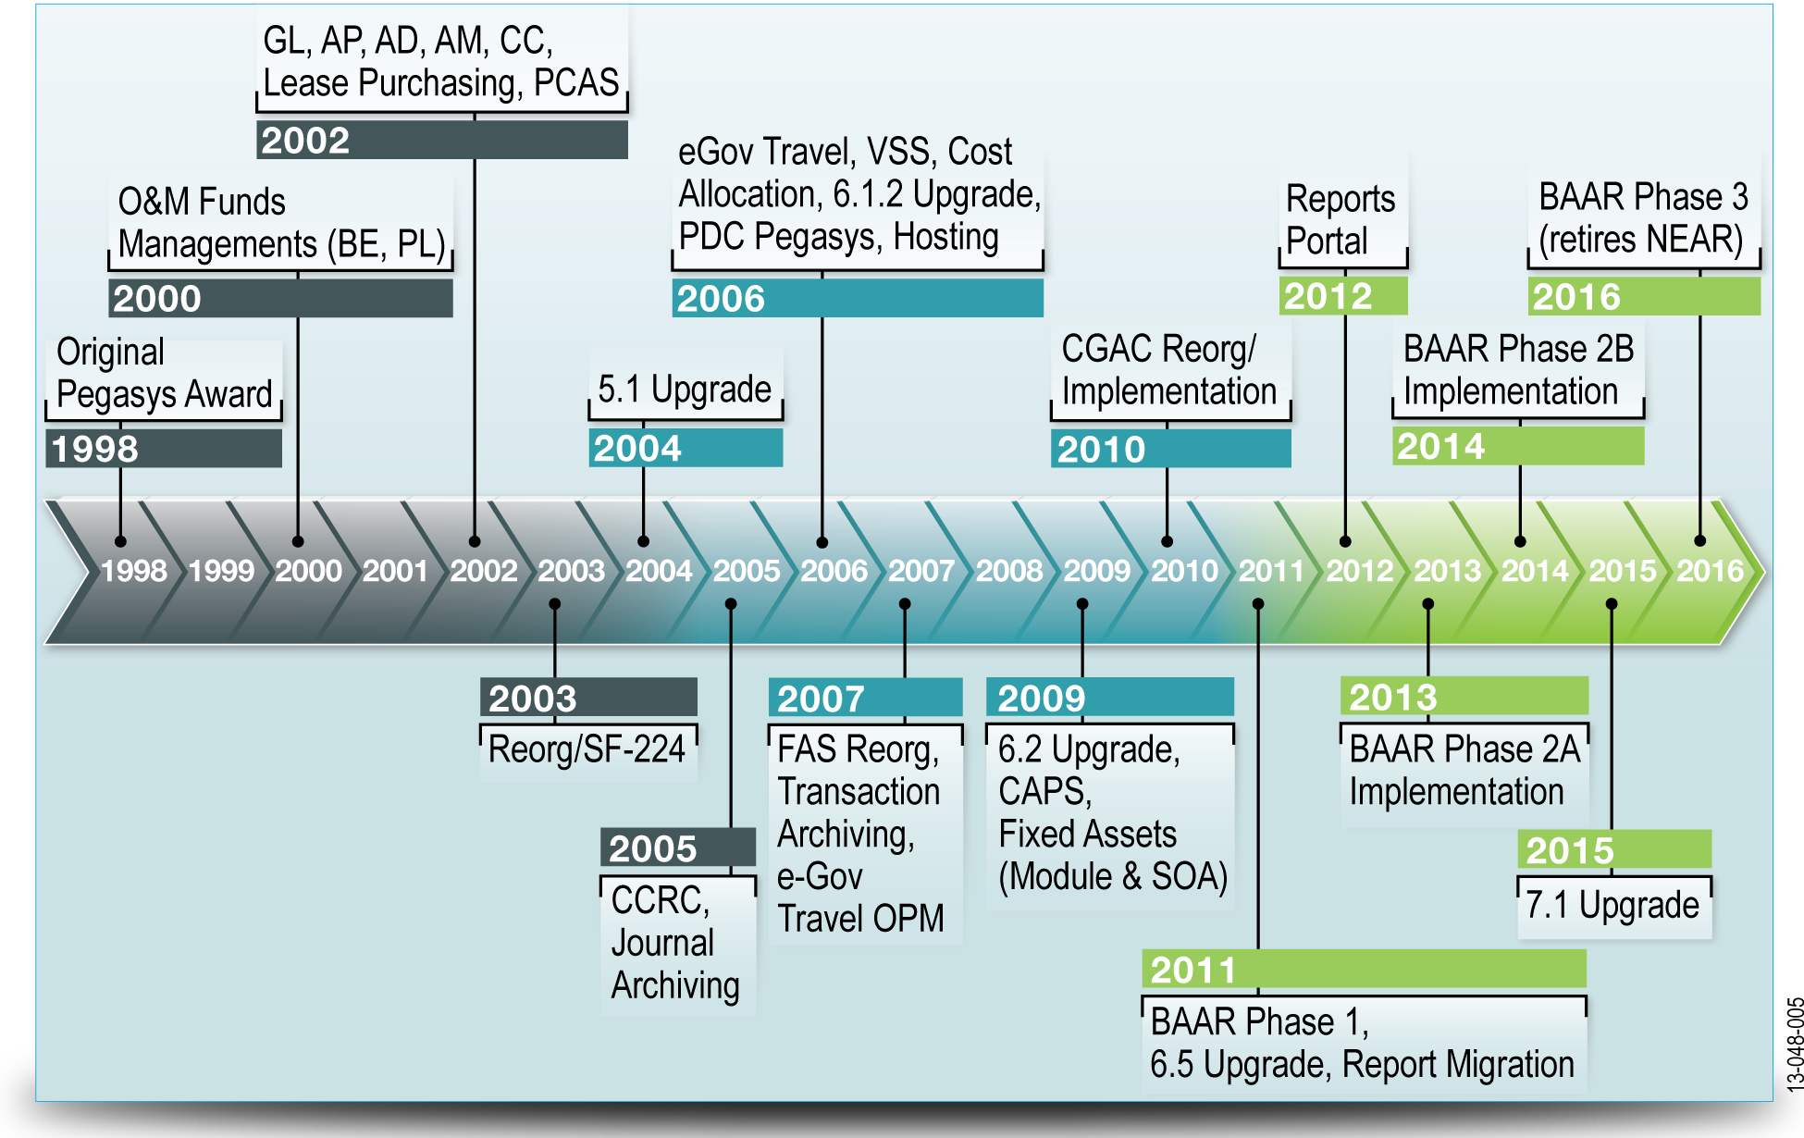
Pegasys History
Pegasys
GSA’s financial system of record delivering comprehensive, federal-specific financial management automation.
7.1.2 upgrade
Incorporates enhancements selected out of160 new features designed to meet current legislative and government-mandated federal financial management requirements and recommendations.
.

Slide 5


7.1.2 Upgrade System Components
Overview of System Components
The Pegasys 7.1.2 Upgrade will impact 5 major system elements:
Pegasys
GSA Interfaces
Non-GSA Interfaces
Reporting
VCSS
Financial Analyst
Customer/Vendor
Pegasys
GSA Interfaces
Vendor/Customer Self-Service (VCSS)
Non- GSA Interfaces
Reports
External Sources that Interface with Pegasys
Notes:
These five components work together to capture and transmit financial and transaction specific data. Will be broken down on following slides.

Slide 6
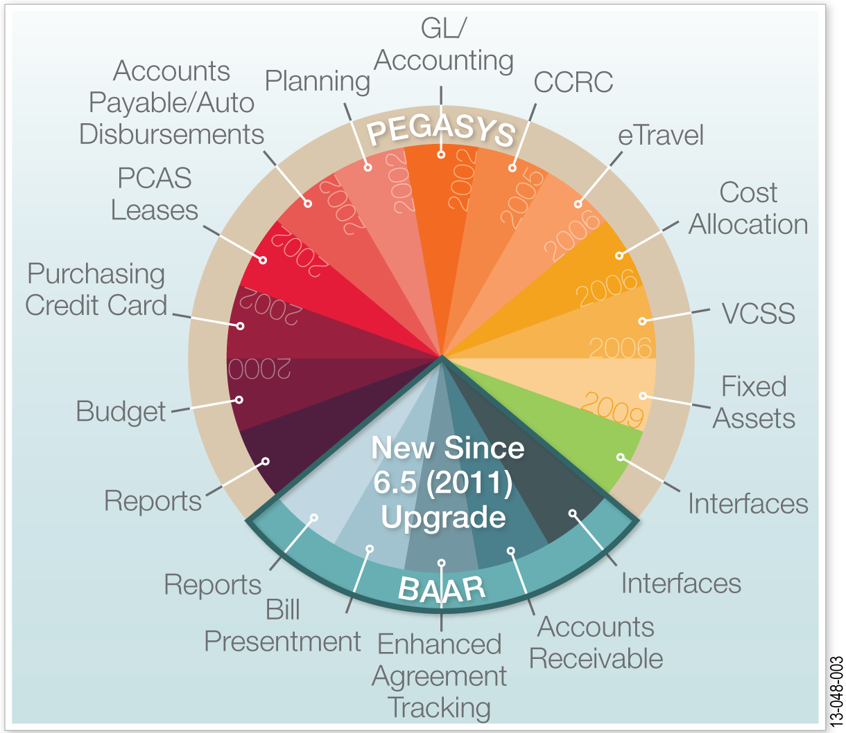
Pegasys
Pegasys Subsystems
List of Subsystems
Accounts Payable
Accounts Receivable
Automated Disbursement
Budget Execution
Credit Card
Fixed Assets
Project Cost Accounting
Purchasing
Travel Accounting
General Systems
Lease/Recurring Services
Reporting

Slide 7
System Components
GSA-Interfaces
Interfaces used to transmit information to/from internal GSA systems to facilitate the transfer of data to Pegasys.
Non-GSA Interfaces
Interfaces that GSA uses to transmit information to/from external, non-GSA systems. This data can be received by GSA or transmitted to external agencies.

Slide 8
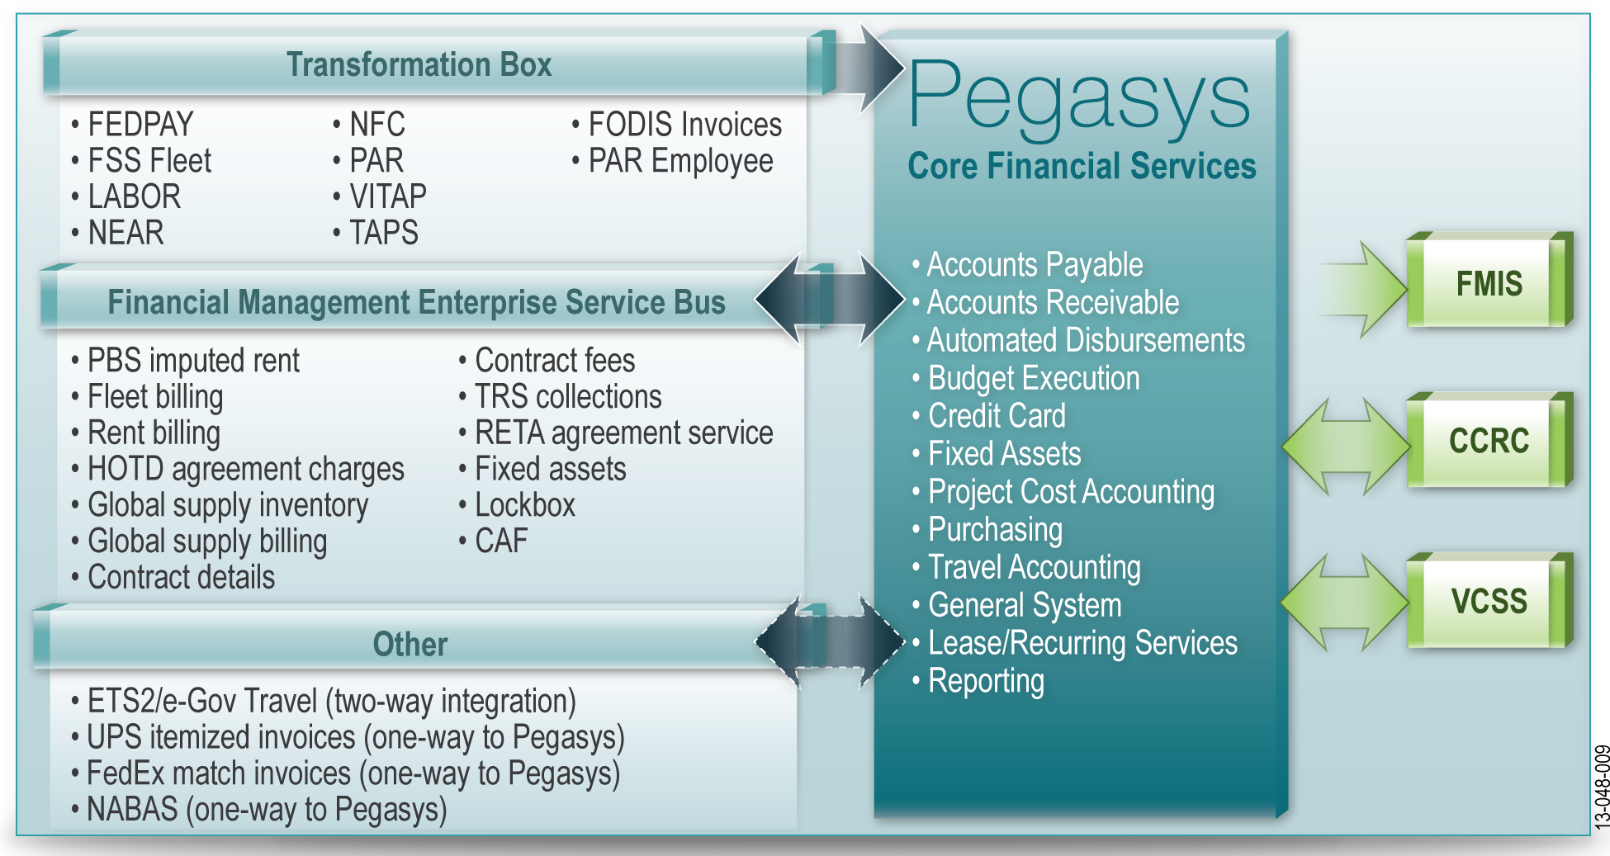
System Components

Slide 9
System Components
Reporting
The Business Objects Universe – allows GSA to generate user queries.
BIRT Reports – standard Pegasys reports.
VCSS
The Vendor or Customer’s Web Portal to their account information in Pegasys.
Allows Vendors to view Invoice and Payment information and Customers to view Billing and Collection information.
Notes:
BIRT Reports – pegasys standard reports layouts. Business objects universe- the database where gsa can create their own custom queries.

Slide 10
Segment 2:
General Systems
Enhancements

Slide 11
General Systems Functionality Overview
General System encompasses the tools and capabilities needed to perform financial activities across the various modules in Momentum. Key aspects of the General System module:
Incorporates reference data common to numerous transactions, such as accounting dimensions and vendor information.
Enables data entry on reference tables, Standard Voucher transactions, and reference data transactions.
Defines and maintains transaction tracking features.
Performs system assurance processes to ensure data is accurate and reliable.

Slide 12
General Systems Enhancement Overview
Relationship Edits on Dimension and Vendor Reference Tables
Add Miscellaneous Reference Functionality to Standard Vouchers and Journal Vouchers
Fund and Cost Total on Lines
Propagate Component TSYM

Slide 13
Relationship Edits on Dimension and Vendor Reference Tables
Relationship Edits are business rules set up within Momentum so that a message is displayed to the user if a transaction violates the rule. Relationship edits can be:
Pre-defined in the system.
Set up by a user to meet specific business rule.
The Relationship Edits Maintenance Table - used to establish and maintain these rules or relationship edits.
Edits can be created for any transaction field in the system, including fields that have been added through extensibility.
Reference > General System > Relationship Edits

Slide 14
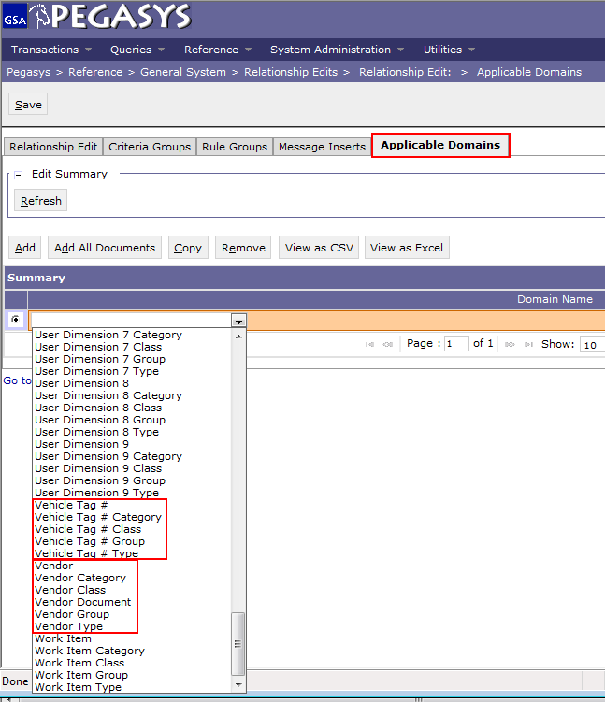
Relationship Edits on Dimension and Vendor Reference Tables
7.1.2. Enhancement
Relationship Edit functionality has been expanded by adding the capability to configure edits for Accounting Dimension and Vendor reference tables.
Allows for the enforcement of relationship edits when creating or updating reference data.
E.g., GSA can configure a Relationship Edit that requires the configuration of a combination of rollups on an Accounting Dimension code, such as requiring a certain Fund Group along with a certain Fund Type.

Slide 15
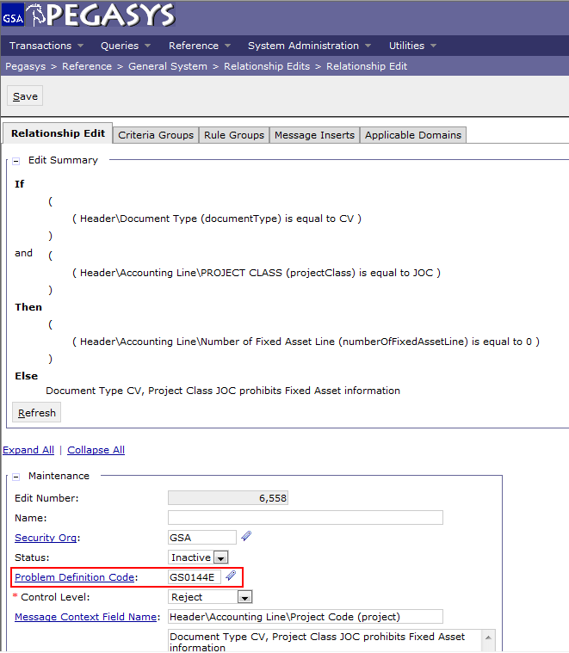
Relationship Edits on Dimension and Vendor Reference Tables
7.1.2. Enhancement
Ability to associate unique Problem Definition codes with Relationship Edits added.
Enables GSA to create its own specialized Relationship Edits by associating a unique Problem Definition code for tracking purposes.
Allows for the specification of a Problem Definition code, security roles can be used to override selected Relationship Edits.

Slide 16
Add Miscellaneous Reference Functionality to Standard Vouchers and Journal Vouchers
Standard Voucher (SV) transactions - used to record miscellaneous accounting transactions that are not included in any of the other Pegasys modules.
Journal Voucher (JV) transactions - used to record non-standard accounting transactions.
Used for any of the Standard Voucher (SV) items when either the elements such as accounting distribution or amount has to differ between the General Ledger accounts or if the posting is so unusual the agency does not want to set up a GL Accounting Entry for it.
Miscellaneous Reference Functionality
Transactions can reference another transaction without any liquidations or tolerance edits in order to capture unanticipated costs that can appear later in the purchasing chain.
Allows the user to associate certain prior transactions without reducing the referenced document’s outstanding amount, and without subjecting the referencing document to tolerance edits.

Slide 17
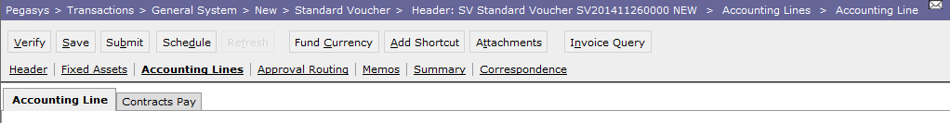
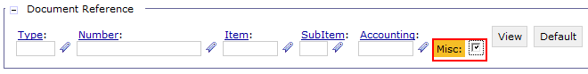
Add Miscellaneous Reference Functionality to Standard Vouchers and Journal Vouchers
7.1.2 Enhancement
SV Reference Capability
Modify SV to allow a miscellaneous reference to the following document categories:
JV Reference Capability
Modify JV to allow a miscellaneous reference to the following document categories:
FA – Acquisition
FC – Correction
FB – Betterment
FM – Manual Depreciation
FT – Transfer
FD – Disposal
NV – Internal Voucher
II – Itemized Match Invoice
CX – Disbursement Cancellation
FA – Acquisition
FC – Correction
FB – Betterment
FM – Manual Depreciation
FT – Transfer
FD – Disposal
NV – Internal Voucher
II – Itemized Match Invoice
CX – Disbursement Cancellation

Slide 18
Propagate Component TSYM System Wide
Business Process
Currently 6.5 TSYM
Pegasys supports a Treasury Symbol that uses the GWA/Star string.
Treasury Symbol is displayed as a single data entry field throughout the system.
New 7.1.2 TSYM
As a result of the evolving Treasury system modernization effort, the structure of the treasury symbol is changing to the Component Treasury Symbol structure.
Pegasys will capture a concatenated component structure to be pushed across all portions of the system that currently capture the treasury symbol.
New treasury symbol composite includes:
Treasury Symbol short key and
Individual fields for all treasury symbol component elements.
All outputs (reports, bills, etc.) will contain the various components of the treasury symbol.

Slide 19
Propagate Component TSYM System Wide
7.1.2 Enhancement
Allows users to view individual component treasury symbol in all areas where the concatenated string is currently displayed in the system.
Transitions all reports to use the new component treasury symbol where the concatenated string is currently used as a parameter or displayed in output.
Allows users to define how the treasury symbol short key is created.
Provides type-ahead functionality to ease data entry burden for the component fields.
Allows users to search on any portion of the component treasury symbol for all queries that currently use the treasury symbol concatenated string as search criteria.
Includes the component treasury symbol on all interface files that currently capture the string treasury symbol.
Add Treasury Symbol to the accounting strip component making it viewable in the document item collection pages.

Slide 20
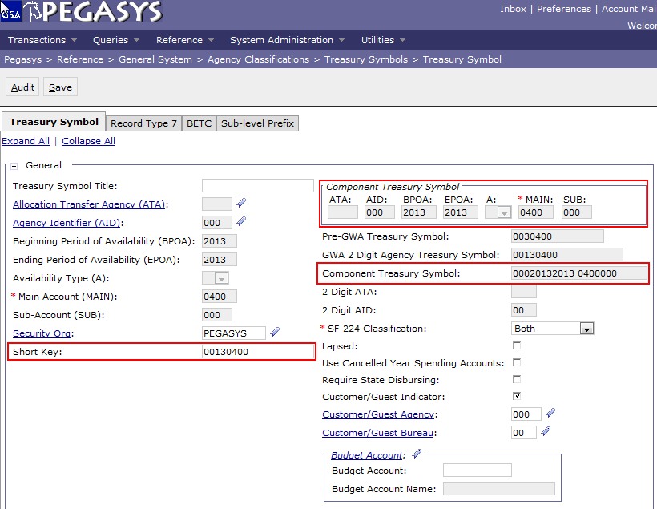
Propagate Component TSYM System Wide
Treasury Symbol Reference Table Updates
The Treasury Symbol maintenance table is used to define valid Treasury Symbols for use in agency activities.
Reference > General System > Agency Classifications > Treasury Symbols
The Treasury Symbol component values are stored separately as individual elements of the treasury symbol rather than as a concatenated string
Comprised of:
(SP) Sub level Prefix
(ATA) Allocation Transfer Agency
(AID) Agency Identifier
(BPOA) Beginning Period of Availability
(EPOA) Ending Period of Availability
Available Type
(MAIN) Main
(SUB) Sub Account
Old String TSYM is stored in Short
Key field
Notes:
Reference > GS> Agency Classifications > Treasury Symbols > Treasury Symbol

Slide 21
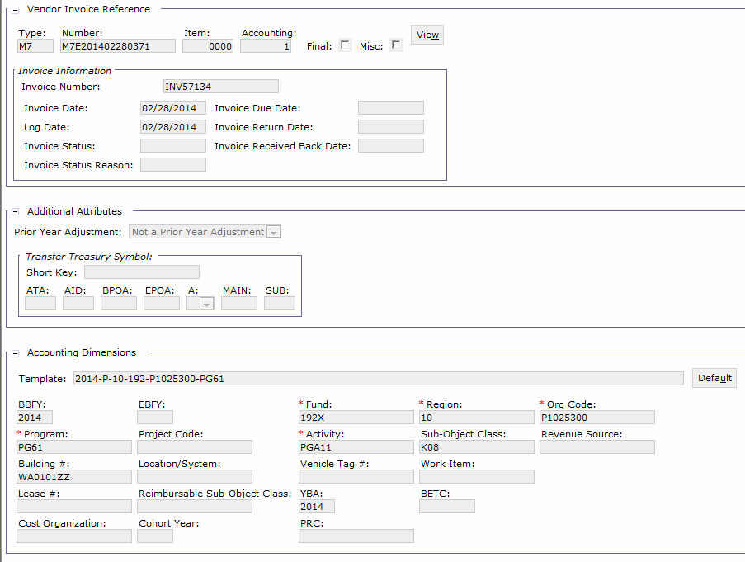
Propagate Component TSYM System Wide
Form and Document Tables Updates
A Treasury Symbol composite will be displayed enabling users to view and enter treasury symbol information.
Allocation Transfer Agency
Agency Identifier
Beginning Period of Availability
Ending Period of Availability
Available Type
Main Account Code

Slide 22
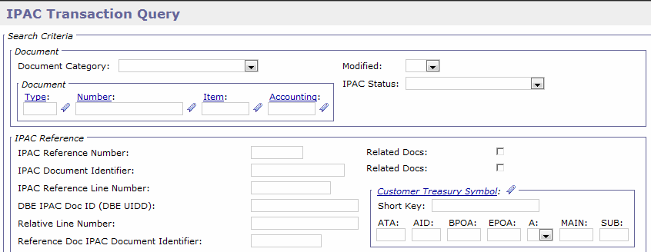
Propagate Component TSYM System Wide
Queries Updates:
Queries will contain the new treasury symbol composite if the existing parameter allowed searching on treasury symbol, customer treasury symbol or transfer treasury symbol.
Query fields will be available where treasury symbol, customer treasury symbol or transfer treasury symbol are visible on corresponding documents.
New treasury symbol composites will be visible on result screens where the accounting strip component is displayed.
The item collections will not show the short key and will only show the component pieces.

Slide 23
Propagate Component TSYM System Wide
Reports
Reports that allow users to establish treasury symbol as a search parameter are modified to use the new treasury symbol composite to include both the short key and treasury symbol components.
All reports will use the short labels for the treasury symbol components as the column.
Batch Jobs
Batch jobs that include treasury symbol as a parameter are modified to include the component pieces instead of the short key.
Jobs that either write the treasury symbol to a file or database table, or read it from a database table or file are modified to handle the new format.
VCSS
Vendor-Customer Self Service Treasury Symbol fields (Treasury Symbol, Customer Treasury Symbol, and Transfer Treasury Symbol) are updated to the Component Treasury Symbol structure.

Slide 24
Segment 3:
Reference Data
Enhancements

Slide 25
Reference Data Enhancement Overview
Product and Service Codes (PSC) Updates

Slide 26
Product and Service Code Updates – Business Process
The Product Service Code (PSC) Group maintenance table - used to store valid groups that classify the product/service codes that characterize commodities as products or services.
Users can define the product/service group and also specify additional information about group.
PSC code group must be set to active to be used.
Reference > Purchasing > PSCs
PSC Codes synchronize between:
Vendor Customer Self Service (VCSS)
Central Contractor Registration (CCR)
Notes:
PSCs are tied to the vendor as a tab on the vendor. This allows us to classify what type of business the vendor does with GSA.

Slide 27
Product and Service Code Updates
7.1.2. Enhancement
The PSC manual has been updated with changes in the reporting of environmental attributes to reflect:
Updates for technology and terminology.
General addition of codes or end dating of codes.
Backend updates for Produce and Service Codes synchronization between Pegasys and other systems:
Updates will be made across systems rather than data mismatching between the systems.
Provides more accurate data to users in both environments and reduces the number of steps to confirm data is accurate (by comparing the data in each system).
No impact on functionality as this enhancement will not make the synching process different than it is currently.

Slide 28
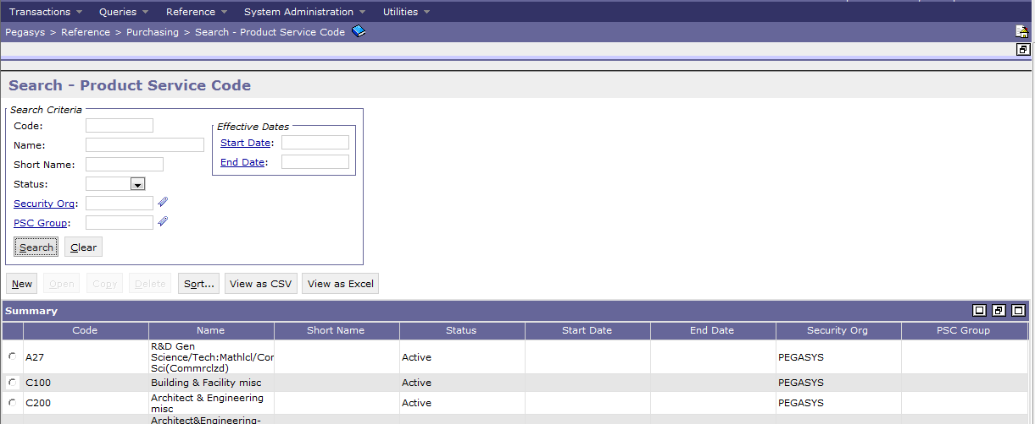
Product and Service Code Updates

Slide 29
Product and Service Code Updates
Pegasys Code Changes
The code structure has three group options: Product, Service, and Research and Development (R&D).
The first service code, A, was for R&D and has been moved to the R&D group.
VCSS Integration
The Product Service Code is displayed on documents transmitted from Pegasys, but can also be searched for and selected on standalone invoices.
The Pegasys PSC table is synchronized with VCSS so that any time a new record is added, existing record is updated, or existing record is removed from the table in Pegasys, the change synchronizes with VCSS.
CCR Integration
PSC can be passed from CCR through CCRC to Pegasys.
When a vendor is published from CCRC to Pegasys, there are validations to make sure that the PSC codes sent over from CCRC exist in Pegasys before any vendor changes are applied or a vendor is added to Pegasys.
Pegasys gives retains codes as ENDED for those no longer used in CCR that are not remove until a vendor renews its CCRC registration (and thus transmitted to Pegasys)
An end date populated to discourage usage so that there are not errors in the integration.

Slide 30
Segment 4:
Fixed Asset Enhancements

Slide 31
Fixed Asset Functionality Overview
The Fixed Assets module:
Provides a means of tracking all information (financial and otherwise) related to assets and their associated betterments.
Allows users to record all of the different steps required to purchase, pay for, and track assets.
Expedites an agency’s asset management process.
An asset:
Is a valuable object that provides a service for an extended period of time and involves a substantial acquisition cost.

Slide 32
Fixed Asset Module - Pegasys
Functions of the Fixed Assets module include:
Record acquisition of assets and associated betterments.
Link assets to related purchasing and payment transactions.
Assign assets to a hierarchy of custodians.
Record a custodial property officer’s acknowledgement of responsibility for an asset.
Post capitalization and depreciation expense to the general ledger for capitalized assets and associated betterments.
Transfer assets and/or betterments to new custodians, accounting distributions, asset type and/or depreciable status.
Record the disposal of assets.
Track asset status and information through queries.
Maintain a detailed audit trail of asset activity.
Notes:
The Asset Type is an agency-defined code assigned to a system-defined classification (e.g., Equipment, Vehicle, Land, Building, Construction in Progress, Antique/Artifact)
Betterments are improvements to an existing asset that increase the asset’s value and/or the asset’s useful life
Betterments enhance assets and consequently, are managed together with the asset
An example of a betterment is a garage addition on an existing building, where the building is the original asset. The garage increases the asset’s functionality and worth
Betterments are defined by a combination of three fields: Asset Type, Asset Number, and Betterment Number. The combination of these fields links the betterment to the original asset while providing the betterment with a unique identity (the Betterment Number)

Slide 33
Fixed Asset Enhancement Overview
Add Asset Number to Journal and Search to Spending History

Slide 34
Add Asset Number to Journal and Search to Spending History
7.1.2 Enhancement
Expands the ability to post and reconcile asset transactions efficiently by providing GSA with additional search criteria to reconcile Fixed Assets data.
Asset Number and Betterment Number fields added to:
Transaction Journal entry
Transaction Journal Query
GL Detail Query

Slide 35
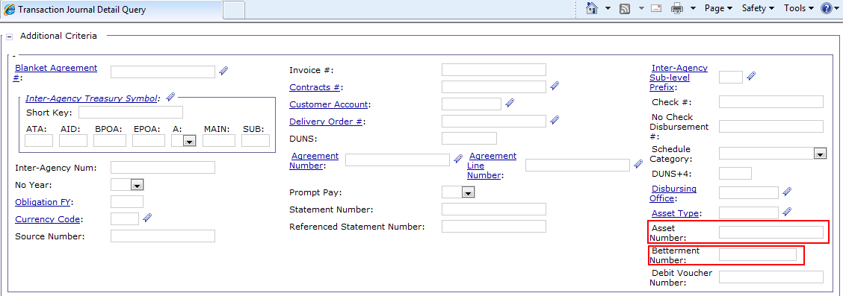
Add Asset Number to Journal and Search to Spending History

Slide 36
Add Asset Number to Journal and Search to Spending History
Asset Query Spending History Updates
Queries > Fixed Assets > Asset Query
New Fields on Spending Details tab
Accounting Period of the transaction.
System Date Time field added to display processing date.
View Document button provides a direct link from query to spending transaction.
From/To Accounting Period, Document Category, Document Type, Document Number, Document Date, Dollar Amount, Document Action, Action
Renamed fields
Date field renamed to Document Date.

Slide 37
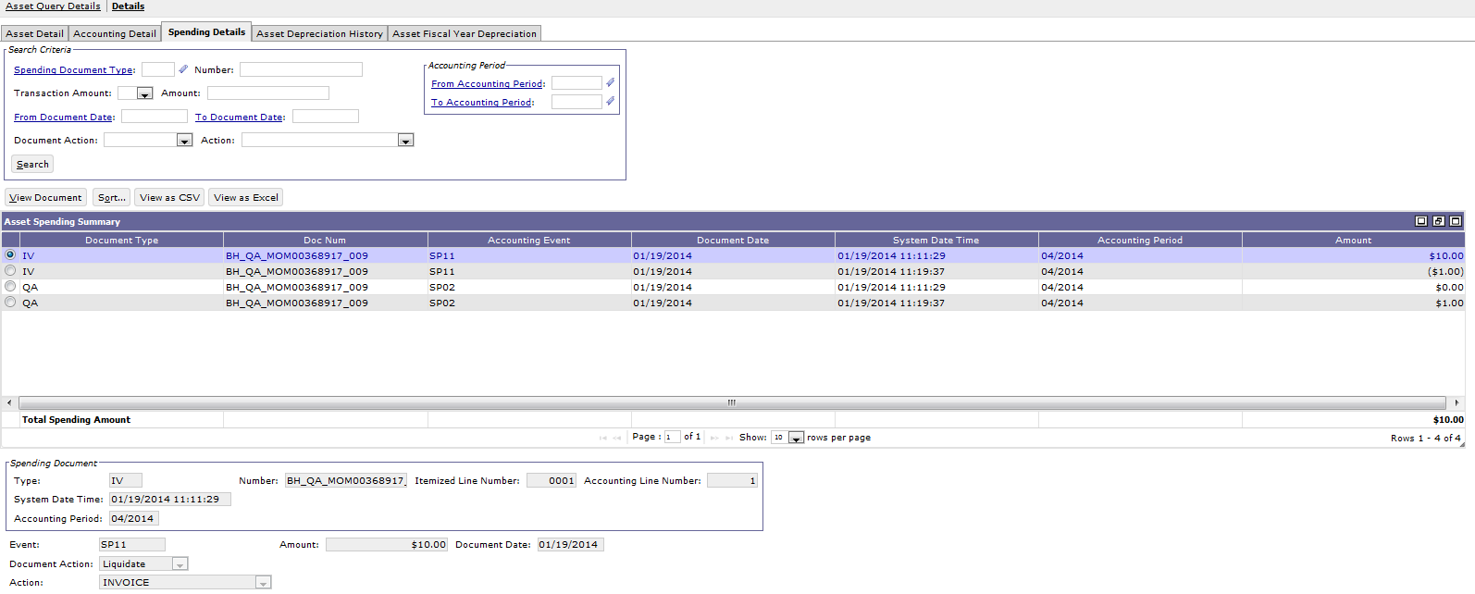
Add Asset Number to Journal and Search to Spending History
Notes:
Asset Query-
Asset Type BUILDING
Select, hit details, spending details.

Slide 38
Segment 5:
General Ledger Enhancements

Slide 39
General Ledger Functionality Overview
The General Ledger (GL) module provides financial tracking and an audit backbone for Momentum.
Performs necessary financial postings for all transactions across all modules.
Provides a complete audit trail of transactions processed in the system.
Provides a journal voucher transaction to record financial activities not handled elsewhere in Momentum.
Notes:
General Ledger Accounts
In order to provide consistent financial reports from one agency to another and to increase federal financial accountability, the federal government created the United States Standard General Ledger (SGL). The SGL is a standard chart of accounts that must be used by all federal agencies.
Accounting Events
To correctly update budgets, plans, projects, agreements, and the vendor activity query, Momentum needs an accounting event for each transaction.
The accounting event tells Pegasys, for example, whether a transaction updates commitments, obligations, or expenditures.
Each GL account type has an accounting event associated with it on the GL Account Type Maintenance table.
each GL account is associated with a GL account type in the GL Account Maintenance table.
The Accounting Event maintenance table is used to set options for Momentum’s pre-defined accounting events. Momentum accounting events:
Signify the type of financial activity performed by a given transaction
Provide a basis for certain accounting-related edits and system updates
Determine the nature of general ledger postings performed by a given transaction
Fiscal Year
Document Type
Transaction Type
Process Activity

Slide 40
General Ledger Functionality Overview
General Ledger Accounts
In order to provide consistent financial reports from one agency to another and to increase federal financial accountability, the federal government created the United States Standard General Ledger (SGL). The SGL is a standard chart of accounts that must be used by all federal agencies.
Accounting Events:
Signify the type of financial activity performed by a given transaction.
Tell Pegasys whether a transaction updates commitments, obligations, or expenditures.
Provide a basis for certain accounting-related edits and system updates (e.g., increase/decrease appropriate amounts on the budget tables).
Maintained on the Accounting Event reference table.
Each GL account type has an accounting event associated with it on the GL Account Type Maintenance table.

Slide 41
General Ledger Enhancement Overview
GTAS - SGL and GL Account Expansion
Annual Close Improvements
Posting Model Information
GL and Entity Rebuild Performance Improvement
Document Reversal Additional Parameters
Multiple Journal Postings for IPAC Payments

Slide 42
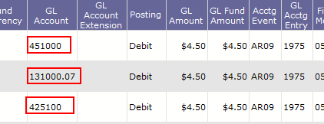
GTAS - SGL and GL Account Expansion
7.1.2 Enhancement
Implements system wide general ledger conversion from the four-digit SGL structure to the six-digit SGL structure.
Transactions
Queries
Reference Tables
Notes:
Speaker Note: Years prior to FY15 will not be updated at go Live with the 6 digit GL numbers. They will be updated within a few months after go-live.

Slide 43
Annual Close Improvements – Business Process
GLACLOSE batch job:
Closes the books at year-end and prepares the GL for the new fiscal year.
Uses Journal Voucher (JV) documents to perform the following GL postings during the Annual Close batch process:
Closing entries - transfers funds from nominal proprietary and budgetary accounts to real or closing accounts at closing year-end.
Beginning Balance entries - brings forward the balance in real and closing accounts at closing year-end by posting the amount at the beginning of the new fiscal year.
GLACLOSE can be run in either Preliminary or Final mode.
Preliminary mode:
Creates the same output file as Final mode, but it does not actually create documents and therefore does not update the journals or GL rollup tables.
Updates a set of preliminary GL rollup tables.
Final mode:
Database updates are made.
Can be run multiple times for the same fiscal year to perform an incremental annual close.

Slide 44
Annual Close Improvements
7.1.2 Enhancements
Preliminary Mode Updates
GLACLOSE is modified to remove the accounting period edit when executing in preliminary mode.
Since there are no documents or postings being processed, there is no need to require the accounting periods to be open when executed in preliminary mode.
Removing edit allows the preliminary run to skip the checking if the closing, reinstatement, and beginning accounting periods are open during its run.
Allows for greater flexibility of its execution in production databases.
Notes:
Go to GL Account Maintenance table, look up 2014/ Code 10*

Slide 45
Annual Close Improvements cont.
Improved Batch Process Error Messages
Provides a better understanding and description of encountered issues.
New problem definitions (error codes and messages)
Displays error messages that exist in the batch log but are not present in the batch job report
Creates new problem definitions for each of these messages allowing them to be present in the batch job report when issues arise.

Slide 46
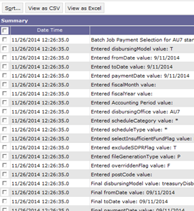
Annual Close Improvements cont.
GLACLOSE Batch Execution Report Timestamp enhancement
Batch execution reporting has been modified to add a flag Save Timestamp to Report on the Batch Job Maintenance Page.
Allows users to state if they would like error messages to display the date/time stamp next to each error message in the batch job report.
Date/time stamp already exists in the logs, but if selected will now precede each error message and be displayed within the batch job report.
Provides better tracking and identifying of issues, while also providing an accurate timing of the execution and receipt of error.

Slide 47
Posting Model Information – Enhancement Features
7.1.2. Enhancement
Creates a process that will generate more comprehensive GL posting model information for agencies for use in research and to provide to an auditor.
Provide a complete breakdown of every unique transaction definition, including which accounts are debited and credited, the specific accounting event, the process activity, and the flexible definition information, for a specified fiscal year
Provides the GL Posting Model information in both query and report form
New Query - can be used for online verification and research
New Report - Displays information by selected fiscal year for distribution to applicable agency and audit personnel

Slide 48
Posting Model Information – Enhancement Features
GL Posting Model Query
Allows users to look up GL Posting Model information filtered by ranges of subsystems, document types, and transaction types and provides the option to look up a specific GL Account Entry. There are three different sections that make up the full scope of the GL Posting Model for the specified search parameters.
Transaction Definition
GL Accounts
Flexible definitions
All the queried results are filtered for manageability by Fiscal Year. If the status search criteria is selected:
Active, then only active transaction definition records are returned
Inactive, then only inactive transaction definition records are returned
Null, then both active and inactive transaction definition records are returned

Slide 49
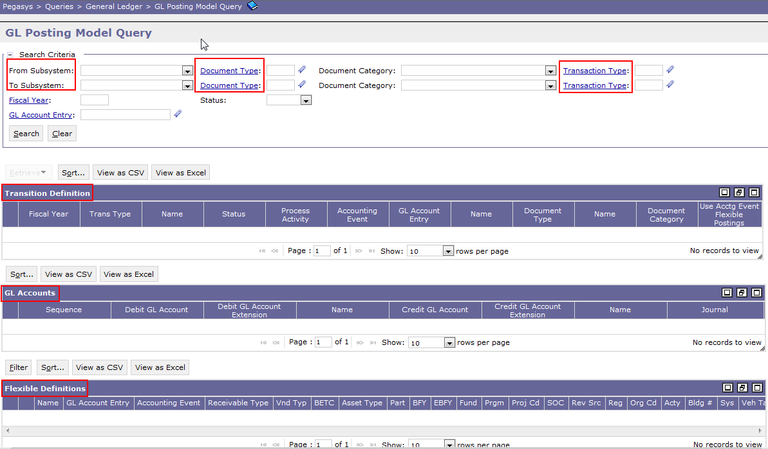
Posting Model Information – Enhancement Features

Slide 50
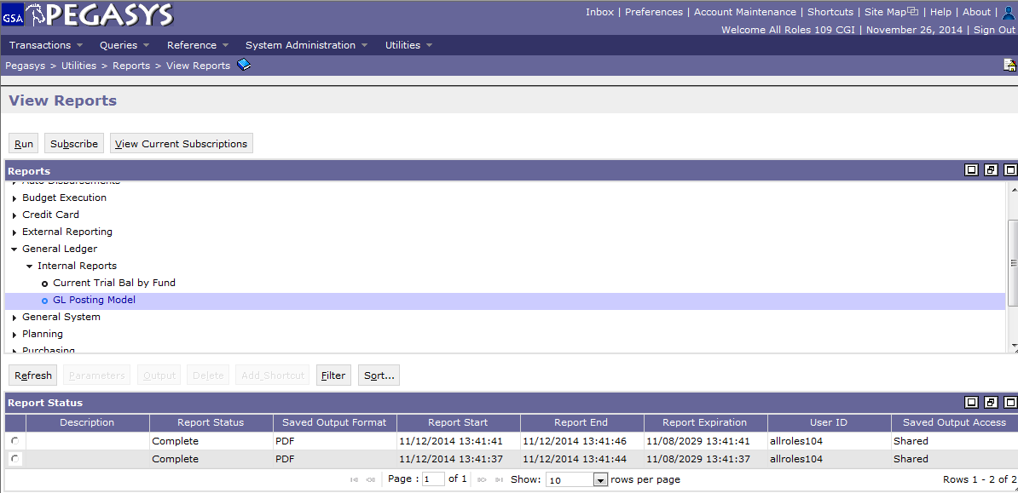
Posting Model Information – Enhancement Features
GL Posting Model Report
Utility > Reports > General Ledger > Internal Reports > GL Posting Model

Slide 51
GL and Entity Rebuild Performance Improvement – GL Rebuild Process
Pegasys contains a set of general ledger rollup tables used for reporting, querying, and annual close purposes that need to be in synch with the online journals.
In the case where the online journals and the rollup tables no longer match, the General Ledger Rollup Rebuild batch process (GLREBUILD) reads the journals and rebuilds the rollup tables.
Pegasys 6.5
When rebuilding the General Ledger Rollup Tables with the GL Rollup Rebuild process, a specific order must be followed:
The Rebuild batch process will summarize the records from the journals into the periodic rollup tables
The periodic balance by fund table (PBBF) is summarized from the periodic balance by distribution table (PBBD)
The periodic balance by distribution table (PBBD) table is in turn is summarized from the periodic balance by vendor table (PBBV)
The periodic balance by vendor table (PVVB) table is summarized from the transaction, accounting, and general journals

Slide 52
GL and Entity Rebuild Performance Improvement
7.1.2 Enhancement Features
Journal Rebuild:
Ability to build any of the periodic tables directly from the journals, instead of relying on previous periodic tables to have been rebuilt first, decreasing the time required to complete the rebuild.
Eliminates the need to rebuild the periodic balance by fund table (PBBF), periodic balance by vendor table (PBBV), and periodic balance by distribution table (PPBD) in a specific order.
Provide the ability to rebuild any of the three periodic rollup tables off of the accounting journals.

Slide 53
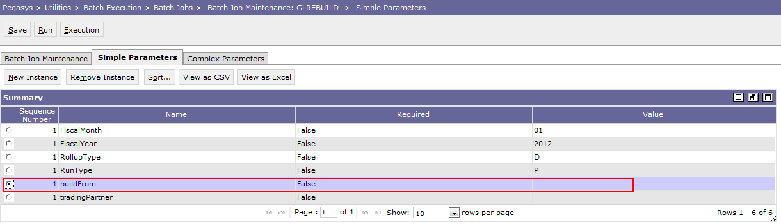
GL and Entity Rebuild Performance Improvement
New batch parameter buildFrom, which will allow users to specify whether to use the accounting journals or periodic tables when executing the GLREBUILD batch process.
Valid values include Null (defaults to P), J (Journals), and P (Periodic). If a user chooses to rebuild using the accounting journals then any of the periodic tables can be built using data from the accounting journals in any specific order.
Only if the tables are being rebuilt off of the periodic tables will they need to be rebuilt in a specific order.
The annual rollup tables will continue to be built off of the periodic tables and currently do not require any specific order to be rebuilt.

Slide 54
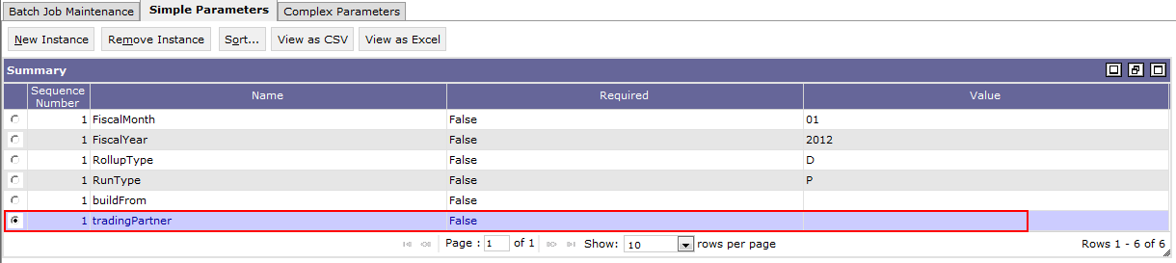
GL and Entity Rebuild Performance Improvement
GL Rebuild Trading Partner parameter:
New tradingPartner parameter will allow users to enter a specific Trading Partner value as a selection parameter.
Provides GSA the opportunity to rebuild a specific set of data if deemed necessary in a shorter amount of time rather than rebuilding for all trading partners.
If the tradingPartner parameter contains a null value then the batch job will select and build data for all Trading Partner values.
If the tradingPartner parameter contains a valid value, then the batch job will select and build data only for the Trading Partner entered as the selection parameter.

Slide 55
Document Reversal Additional Parameters – Business Process
The Document Reversal process reverses the amount of document lines to equal the closed amount, resulting in an outstanding amount equal to zero. In addition the user may choose to reinstate cancelled payables for financial statement presentation.
The ACDOCRVS batch process can be run at any time during the year and is also used specifically during annual close to perform the following actions:
Reverses outstanding pre-commitments, commitments, obligations, accruals and payables associated with funds that expire or cancel at the fiscal year-end.
At year-end this process is run for expiring and cancelling funds, as determined by the Fund Status and Fiscal Year parameters.
Reinstates cancelled payables
The user may choose to reinstate cancelled payment and receipt document amounts for financial statement purposes.
Can be run in preliminary or final mode
Notes:
Reverses outstanding pre-commitments, commitments, obligations, accruals and payables associated with funds that expire or cancel at the fiscal year-end.
At year-end this process is run for expiring and cancelling funds, as determined by the Fund Status and Fiscal Year parameters.
The system selects any open line where the funds BBFY is less than or equal to the Fiscal Year Parameter, and the funds Expired Year or Cancelled Year on Fund Maintenance is less than or equal to the Fiscal Year parameter + 1 and modifies the open amount to zero. A report is generated listing all items closed.
Reinstates cancelled payables
The user may choose to reinstate cancelled payment and receipt document amounts for financial statement purposes.
If the Reinstate Cancelled Payables parameter is set to true, the process creates a SV form to reinstate each cancelled payable in the appropriate GL accounts.
The form uses an Expenditure transaction event with the transaction type entered in the parameters.

Slide 56
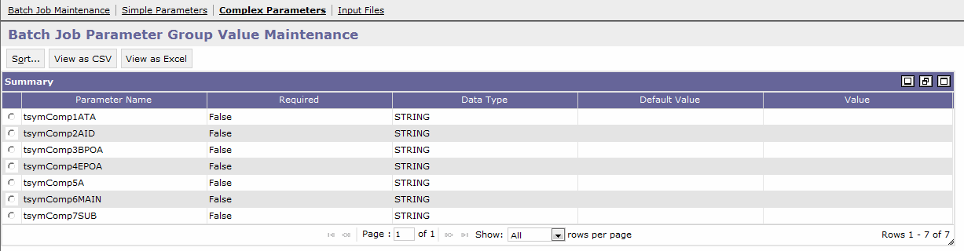
Document Reversal Additional Parameters
7.1.2 Enhancement
Annual Close Document Reversal Batch Process (ACDOCRVS) moved Parameters:
Treasury Symbol will be moved to the complex parameters.
Enables users to define multiple 'or' conditions that a document or line must meet before it can be reversed.
For each complex parameter group, the following new parameters will be available:
Include/Exclude Flag identifies whether a given complex parameter group defines inclusion logic versus exclusion logic
Rollups for each dimension code allow users to define inclusion or exclusion logic based on the rollup values such as organization category

Slide 57
Multiple Journal Postings for IPAC Payments – Business Reason
IPACOUT Business Process
The IPAC Outbound Batch process updates values on Billing Document, putting it into a ‘billed’ status.
IPAC Outbound also selects billing and payment transactions in the system and creates an upload file for Treasury.
Currently, as IPAC payments are processed, the functionality mirrors that of a No-Check disbursement. The IPAC IP is considered fully disbursed and typically posts to a posting model that includes the Treasury cash account (1010).
However, when payments are submitted to IPAC the funds are not actually transferred until the payment clear Treasury and customer agency edits.
This means there is a possibility the payment can be rejected.
In order to keep the accounting in line with the activity at Treasury, and also to allow for delays in said cycle, GSA needs the ability to hold off posting the IPAC payment as fully disbursed until the payment is confirmed by Treasury. The confirmation of the payment can be a day or two later and is performed by the IPAC inbound process (GSIPACIN).

Slide 58
Multiple Journal Postings for IPAC Payments – Business Reason
The Multiple Journal Postings for Intra-Governmental Payment and Collection (IPAC) Payments (IPs) enhancements provides GSA the ability to reflect IPAC Payments in transit and confirmation activity in the journals by adding an IPAC Disbursement in Transit and IPAC Reconciliation process.
Similar to the existing disbursement that payments have for automated disbursements (Treasury, Banking, State, and Agency disbursing methods).
Enable GSA to postpone journal updates to the cash posting model until the confirmation of the transfer of funds is received from IPAC
Not typically received the same time the IPAC payment is initially processed or submitted to Treasury via IPAC Out.

Slide 59
Multiple Journal Postings for IPAC Payments
7.1.2 Enhancement
IP Transaction Updates:
Payment Authorizations (IP) will be modified for so that there are two additional Process Activities used in IPAC processing:
IPAC Disbursement in Transit
IPAC Reconciliation
IPAC payments are defined as IPs with:
The Disbursing Method equal to Inter-Agency AND
The Type of Transfer set to IPAC.
Inter-Agency Transfer Payments that do not have Type of Transfer set (Type of Transfer is blank) are not included.
Does not affect IPAC Billing Documents, IPAC Cash Receipts nor will it include/necessitate any change to payment documents created by the GSIPACIN process.

Slide 60
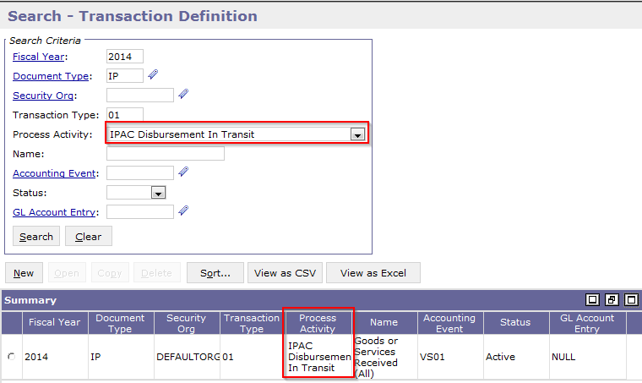
Multiple Journal Postings for IPAC Payments
7.1.2 Enhancement
Query Updates
The Transaction Journal Query and GL Detail Query will have the Process Activities added:
IPAC Disbursement in Transit
IPAC Reconciliation
Reference Data updates
For Payment Authorizations (IP) only, the Transaction Definition Table will have an IPAC Disbursement in Transit process activity and an IPAC Reconciliation process activity added.

Slide 61
Multiple Journal Postings for IPAC Payments
7.1.2 Enhancement
Batch job updates
GSIPACOUT:
Modified to add a liquidating journal entry for the IPAC Disbursement in Transit process activity when the payment is successfully included in the outbound file and has the IPAC Status updated from Not Submitted to In Transit.
Applies to final mode of GSIPACOUT only
GSIPACIN:
Modified to liquidate the outbound IPs IPAC Disbursement in Transit process activity by adding a liquidating journal entry for the IPAC Reconciliation process activity when the payment is successfully processed and IPAC Status updated from In Transit to Confirmed.
Applies only to IPs the submitted to IPAC by Pegasys.
Does not apply to customer initiated IPs newly created by the GSIPACIN or IPs used outside of the IPAC processes.

Slide 62
Segment 6:
CCRC Enhancements

Slide 63
CCRC Business Reason
CCRC is a web-based application that provides the ability to:
Store and manage Business Partner Network (BPN)/Shared Accounting Module (SAM) vendor records before they are uploaded into Pegasys.
Uploads records into Pegasys.
Provide daily updates to the database with changes released by BPN/SAM on an incremental basis.
The CCRC User Interface enables users to specify which vendors are to be transferred from the CCRC to GSA applications.
Contains information regarding when vendor records change in the database:
When a new vendor data has been received.
When an active vendor changes.
When a vendor has been inactivated or deleted.
CCRC Cycle:
Notes:
CCR- contractors that do business with government. Movement to make comprehensive database and consolidate with CCRC info, now called SAM, system for award management. All agencies need to use sam file format to extract contractor information. CCRC- momentum application that extracts contractor information to extra to do business with. If they select publish and it creates a vendor in pegasys.
We take input file from sam, large file with large data set. Agencies then take file daily to take changes, and publishes to CCRC and then it gets publishes to pegasys and reflects on vendor table.

Slide 64
CCRC Functionality
CCRC notifies GSA of these changes by publishing (sending their information) to Pegasys.
CCRC allows for one initial load which pulls all the information collected by SAM and imports that data into the CCRC.
GSA is then able to use CCRC for the Initial Vendor Selection to select the vendors with whom they intend to do business and sends vendor data to Pegasys.
There are two types of updates available from CCRC:
Monthly Load File
Used for initial Load
Daily Load File
Used for updates to CCRC system

Slide 65
CCRC Enhancement Overview
SAM Entity Management - Data Import Capabilities
SAM Entity Management - Capture Additional Data
CCRC Case Insensitive Queries
CCRC Tax ID Number Field Update

Slide 66
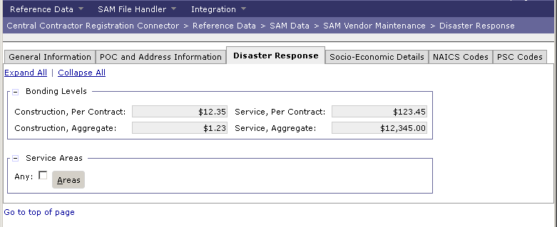
SAM Entity Management – Data Import Capabilities
7.1.2. Enhancement
Expanded data import capabilities:
Will provide an easier transition to supporting the new SAM extract file formats.
SAM introduces new data elements that were not available previously such as:
Delinquent Debt
Disaster Response Indicators
New configuration options:
Allows CCRC to process the new SAM extract file format.
Updates Pegasys and VCSS to have new fields from SAM.
Notes:
You can from sam import information such as delinquent debt and disaster response indicators.

Slide 67
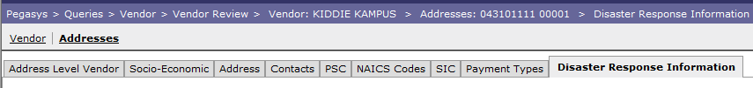
SAM Entity Management – Capture Additional Data
7.1.2 Enhancement
Introduces changes to both Pegasys and the Central Contractor Registration Connector (CCRC) module.
Updates for Pegasys:
Updates include terminology changes and additions that captures more data elements than were previously recorded by the SAM predecessor, CCR.
A new overrideable warning for a vendor's Delinquent Federal Debt.
Increasing the database length of vendor names and postal codes throughout the system.
The addition of Disaster Response information to the vendor record.
The addition of a reference-backed County maintenance table in Pegasys to validate counties entered on vendor records.
The option to record a Bureau for an Agency Location Code in Pegasys.
Notes:
Go to Vendor Review Query, search for *1111, show Disaster Response tab
Today these fields are in CCRC. They will be in pegasys. Anyplace in Pegasys that says CCRC now renamed SAM.
Comes from SAM to CCRC, sent over to Pegasys.

Slide 68
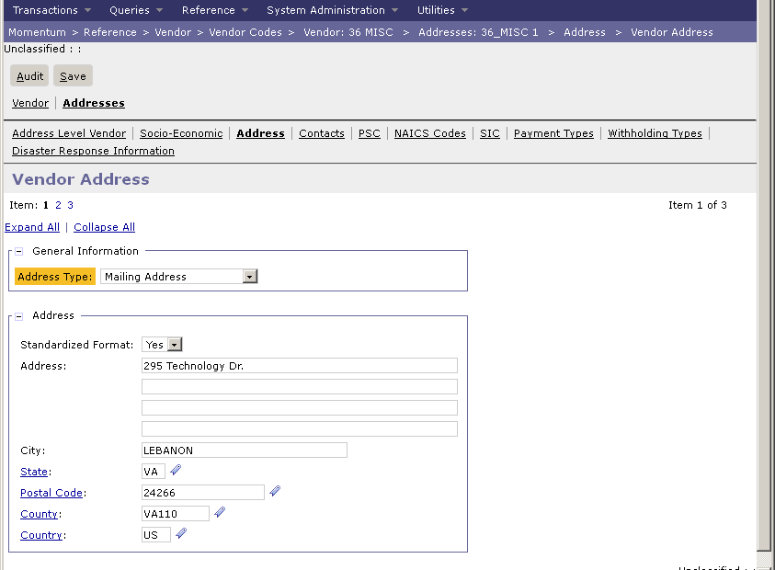
SAM Entity Management – Capture Additional Data
7.1.2 Enhancement
Updates for Pegasys:
The addition of a fourth address line to the "Standard" address format.

Slide 69
CCRC Case Insensitive Queries
7.1.2 Enhancement
Modifies certain text fields on CCRC queries to support case insensitive searches.
Vendor Search:
Holiday Maintenance Table: Description
Document Management: Document Name
WebMethods Maintenance: Server Id, Service Name
WebMethods Error: Server Id, Service Name
Cross Reference: Application Id, Native Id, Object Name
Batch process Status: Job Definition, Step Name
Search criteria can be entered either upper or lowercase, and have all matching results returned, regardless of the case of the results.
Legal Business Name
Agency Location Code
CAGE Code
DBA Name
DODAAC
City
Country
State or Province
Postal Code
PSC Code
St Add 1- St Add 2
Address Line 1- Address Line 4

Slide 70
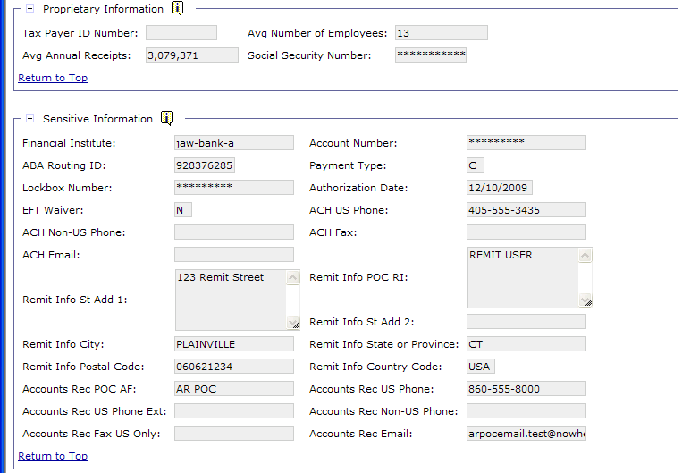
CCRC Tax Number ID Field Update
7.1.2 Enhancement
Applies the Confidential Data Policy to the Tax ID Number and Social Security Number fields in CCRC, preventing users without proper permissions from viewing sensitive data.
Prevents viewing of sensitive data from users without proper permissions, not searching.
Fields are optionally masked from a user without the correct security groups associated to their user id.
Users with proper permissions can see relevant data.

Slide 71
Segment 7:
Billing Enhancements

Slide 72
Accounts Receivable Functionality Overview
The Accounts Receivable module gives GSA the ability to record, monitor, and control all activities associated with GSA’s billing and collection process.
Allows GSA to establish different types of unbilled receivables, bill & track the receivable, and process a collection.
Receivables for the following billing methods are generated via Detail Billing Records or PCAS.
Generated by Detail Billing Records
Standard Non-IPAC
IPAC
Interfund/Intrafund
Revenue Credit Card
DoD Interfund
Generated by PCAS
Standard Non-IPAC
IPAC
Interfund/Intrafund

Slide 73
The General Receivables Lifecycle
Record Collection
Disputes/
Chargebacks
Process Write off/ Adjustment
Generate Receivable and Earned Revenue
Send Bill to Customer
Track Receivable & Record Overdue Charges
Establish Detail Billing Records or Agreement in Pegasys
Note: Not all steps will apply to every Receivable. These are potential events in the AR Life Cycle.
Notes:
Global Supply will generate Receivables via the DBR lifecycle

Slide 74
Accounts Receivable Lifecycle
The Receivables Lifecycle includes:
Importing Detail Billing Records from external billing systems, adding Pegasys-specific information where appropriate on the incoming records, and issuing a report of the positive and negative confirmations OR Establishing an Agreement.
Creating Billing Documents and defining a status of unbilled or billed for receivables.
Billing customers.
Recording revenue and funds collected by GSA.
Dunning customers for outstanding amounts owed to GSA.
Allowing customers to dispute bills (Non-IPAC) and chargebacks (IPAC).
Entering write-off transactions to offset uncollectable debt.

Slide 75
Billing Enhancements Overview
Customer BETC Default
Distinct Collection Due Dates for Federal and Non Federal Vendors
GS Options table
Document Processing Logic
ARBILLGEN Processing Logic
Modify IPAC Functionality

Slide 76


Customer BETC Business Reason
Treasury FMS mandate of becoming a GWA reporter by Oct 1, 2014
Government agencies are required to submit a Business Event Type Code (BETC) along with their Treasury Account Symbols (TAS or TSYM) for all Intragovernmental Payment and Collection (IPAC) transactions.
Allows agencies to better comply with GWA reporting
GSA will be required to submit the Component Treasury Account Symbol and Customer BETC for all GWA reporting trading partners.
Notes:
The BETC is an 8 character code used in the Central Accounting Reporting System (CARS, formerly named the GWA system) to indicate the type of activity being reported, such as payments, collections, investments, etc. This code must accompany the Treasury Account Symbol (TAS) and the dollar amounts in order to classify the transaction against the fund balance with Treasury.

Slide 77

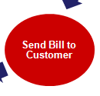

Customer BETC – IPAC Business Process
Intra-Governmental Payment and Collection (IPAC) interface
IPAC is a Treasury system facilitating intra-governmental (agency to agency) transfers of funds, which streamlines billing/collections for GSA.
When sending the bill to customer, IPAC functionality includes an Outbound Process (to Treasury).
IPAC billing and payment transactions are selected by the system and a file is created that is uploaded to Treasury.
When receiving a collection from customer, IPAC functionality includes an Inbound Process (from Treasury).
IPAC collections are received for:
Confirmation of IPAC bills sent to the customer via IPAC.
Collection of non-IPAC bills where customer chose to remit payment via IPAC.
Notes:
a file is downloaded from Treasury's IPAC system, IPAC Search separates the BAAR data and then the inbound process is run to import the data.
GSA gets two types of transactions from the inbound process. We receive confirmation transactions that applies the cash from our IPAC billings. We also receive payments from our customers for our Non-IPAC billings, where the customer sends us payment via the IPAC system.

Slide 78
Customer BETC – Enhancement Features
7.1.2 Enhancement Features
Provides the ability to default the Agency and Customer BETC for certain document category/line type combinations.
Modifies logic to allow agencies to default BETC based on document category/line type combinations, Document category/line type combinations included are:
Billing Document-Normal
Billing Document-Credit
Cash Receipt-Normal
Cash Receipt-Advance Offset
Cash Receipt-Debit Voucher Normal
Itemized Payment-Normal
Itemized Payment-Advance Refund
Notes:
GDIM0000016-0002

Slide 79
Customer BETC – Enhancement Features
Document Category
Line Type
BETC
Normal TSYMs
Billing Document | Normal | DISB
Cash Receipt | Normal | DISB
Billing Document | Credit | COLL
Itemized Payment | Normal | COLL
Itemized Payment | Advance Refund | COLL
F Availability Type TSYMs (Clearing/Suspense Accts)
Billing Document | Normal | DISBBCA
Cash Receipt | Normal | DISBBCA
Billing Document | Credit | COLLBCA
Itemized Payment | Normal | COLLBCA
Itemized Payment | Advance Refund | COLLBCA
Notes:
The BETC is an 8 character code used in the Central Accounting Reporting System (CARS, formerly named the GWA system) to indicate the type of activity being reported, such as payments, collections, investments, etc. This code must accompany the Treasury Account Symbol (TAS) and the dollar amounts in order to classify the transaction against the fund balance with Treasury.
If Beginning Period of Availability and Ending Period of Availability have values, the Availability will be Null.
If BPOA and EPOA are null, the Availability Value is populated.
Availability Type Code (A) Identifies no-year accounts “X”, clearing/suspense accounts “F”, and Treasury’s central summary general ledger accounts “A”. Not applicable if BPOA and EPOA funds used.

Slide 80
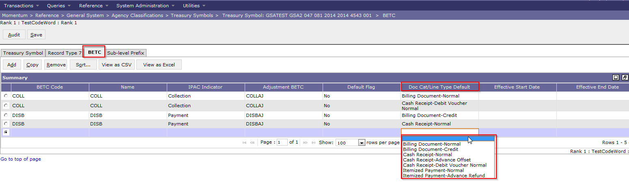
Customer TSYM – Enhancement Features
Additional Areas of impact:
Treasury Symbol Reference Table Item Collection BETC tab:
Adds the Doc Cat/Line Type Default drop-down with valid values of:
Reference > General Systems > Agency Classifications > Treasury Symbols
Null | Cash Receipt - Normal | Itemized Payment - Normal
Billing Document - Normal | Cash Receipt - Advance Offset | Itemized Payment – Advance Refund
Billing Document - Credit | Cash Receipt - Debit Voucher

Slide 81
Distinct Collection Due Dates for Federal and Non Federal Vendors
Unbilled Receivables Business Process:
Unbilled Receivables are created via the DBR billing method or PCAS billing method, generating Billing Documents.
Non-IPAC
IPAC
Revenue Credit Card Billing
DoD Interfund
Upon generating an Unbilled Billing Document, the document continues to the Bill Generation Process (cont. next slide).
Collection Due Dates for Federal and Non-Fed Vendors are inserted.

Slide 82
Distinct Collection Due Dates for Federal and Non Federal Vendors
ARBILLGEN batch process:
Updates billing transactions, indicating the transaction has been “billed” or sent to the customer.
Selects and prepares bills for printing.
Auto-executes the Bill Generation report, which produces the individual bills and a consolidated file containing all the bills in the Batch run (grouped by statement).
Once printed, the bill/statement can be transmitted/viewed in VCSS (Vendor/Customer Self Service).
The bill/statement can be transmitted/viewed in VCSS if the statement's vendor is registered in VCSS.
On the document, ARBILLGEN updates:
Bill Print Date, Last Bill Date, Collection Due Date
Set equal to “Print Date” parameter by ARBILLGEN.
Last Bill Amount- Accounting Line field
Set equal to outstanding line amount.
Notes:
Note: ARBILLGEN also updates the "Billing Status" and "Statement Generated" flags for Non-IPAC transactions. (Note: The update to these two fields is performed by IPACOUT for IPAC transactions)

Slide 83
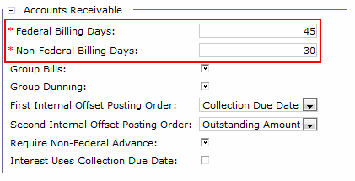
Distinct Collection Due Dates for Federal and Non Federal Vendors
7.1.2 Enhancement Features
GS Options table
Updated/new fields will allow agencies to set distinct billing days for Federal vs. Non-Federal Vendors.
Billing Days field - renaming to Non-Federal Billing Days.
Adding a new Federal Billing Days field.

Slide 84
Distinct Collection Due Dates for Federal and Non Federal Vendors
7.1.2 Enhancement Features
Billing Document Processing Logic
If:
The Collection Due Date is Null and
The Bill Print Option is External
Then:
Pegasys locates the reporting attribute of the designated agent (if applicable) or vendor to see if it is a Federal or Non-Federal vendor.
Pegasys calculates the applicable billing days based on the calculation from the GS Options maintenance table.
Notes:
A vendor is considered a Federal vendor if the reporting attribute is “Government.” All other reporting attributes are considered Non-Federal.

Slide 85
Distinct Collection Due Dates for Federal and Non Federal Vendors
7.1.2 Enhancement Features
ARBILLGEN Processing Logic
If:
The Collection Due Date is Null and
The Bill Print Option is Yes/Suppress
Then:
Pegasys locates the reporting attribute of the designated agent (if applicable) or vendor to determine if it is a Federal or Non-Federal vendor.
Pegasys calculates the applicable billing days based on the calculation from the GS Options maintenance table.

Slide 86
Modify IPAC – IPAC Process
IPAC Inbound (from Treasury) - used to upload the IPAC Search file into Pegasys in order to create collections.
Collections are created against IPAC and non-IPAC Bills.
IPAC Inbound creates the following types of transactions:
Confirmations of IPAC Outbound Billings:
Bill Confirmations/Collections (Cash Receipt documents)
IPAC Inbound typically used to confirm bills submitted to Treasury via IPAC.
New transactions not initiated by GSA via IPAC Outbound or GOALs
Push Payments (Cash Receipt documents)
Cash Receipts that reference non-IPAC Bills or have no reference document found by the system.
Pull Payments (Itemized Payment documents)
Itemized Payments that reference non-IPAC Bills or have no reference document found by the system.
Adjustments/Chargebacks (Cash Receipt and Itemized Payment documents)
Chargebacks of bills/refunds.
Transactions received from IPAC are often inaccurate or missing data, making an automatic reconciliation difficult.
Notes:
Pull of non ipac credit- We have a customer credit we think we owe the customer. Refund generation Copies forward into IP to pay out. Before we can the customer pulls an IP that does not have the correct doc reference.
Push- customer pushes us money before we can pay them.

Slide 87
Modify IPAC – Business Process
Push Payments (Cash Receipt documents)
Cash Receipts that reference non-IPAC Bills or have no reference document found by the system.
Previously, additional documents were created to make such corrections.
Now, collections can be manually corrected as part of the reconciliation process to:
Liquidate a prior bill by adding a reference document to the line, or
Reduce the amount of the line and add a subsequent line(s) that references additional document(s) with the same vendor.
Pull Payments (Itemized Payment documents)
Itemized Payments that reference non-IPAC Bills or have no reference document found by the system.
Previously, additional documents were created by agency users (manually) to make such corrections.
Now, payments can be manually corrected as part of the reconciliation process to:
Liquidate a prior obligation by adding a reference document to the line, or
Reduce the amount of the line and add a subsequent line(s) that references additional document(s) with the same vendor

Slide 88
Modify IPAC – Enhancement Features
7.1.2 Enhancement Features
Introduces the capability to make select modifications to these transactions based on Document Type and IPAC Status.
Document Updates – Field updates:
Provides GSA the ability to manipulate information on IPAC Inbound-generated transactions, including:
Vendor Code/Address Code
Pegasys Reference Document
Amount
Accounting Dimensions
Other Non-IPAC Data Fields
Modifications can be made to transactions with IPAC Status = “Received” or “Pending” and without a reference to another IPAC transaction:
Received” documents that meet the criteria above will be able to be cancelled if the document is not being referenced.
Notes:
CB6/CB7, IR6/IR7
Doc Cat = IP6
From Date = 3/1/2014
Doc Num = CB6201411120000
CB6201408150008

Slide 89
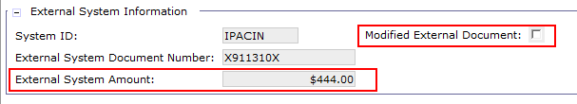
Modify IPAC – Enhancement Features
7.1.2 Enhancement Features
Document Updates cont. - New Fields:
External System Amount - tracks the amount of the transaction recorded in the IPAC File.
Added to the CR and IP Header and Accounting Line.
Modified External Document – flag set if the user changes the dollar amount on accounting lines/itemized funding lines from what was received via IPAC.
Added to the CR and IP Accounting Line/Itemized Funding Line, document header, and Item Collection.

Slide 90
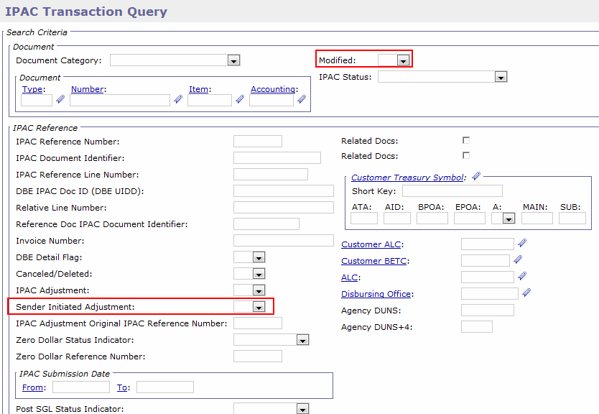
Modify IPAC – Enhancement Features
7.1.2 Enhancement Features
IPAC Transaction Query new fields:
Added to the IPAC Transaction Query Search Criteria, Item Collection, and History page.
Modified flag - set to True when user updates are made to Push and Pull payments.
Sender Initiated Adjustment flag – set to Yes when transaction is initiated by customer.

Slide 91
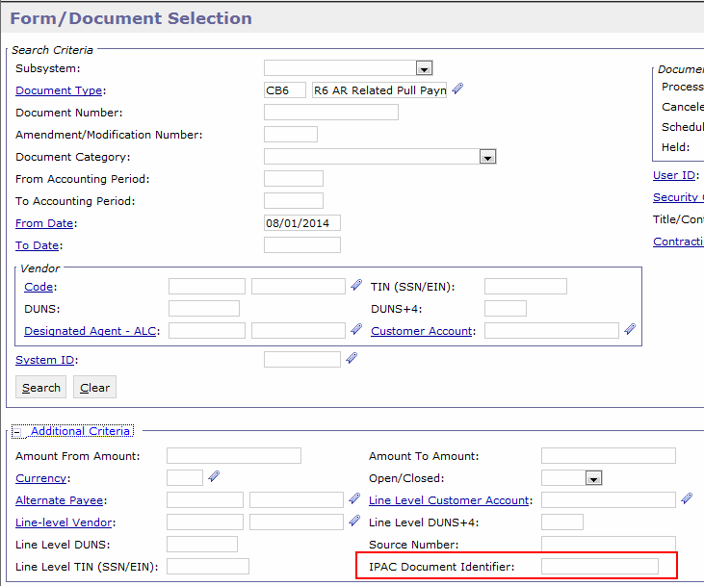
Modify IPAC – Enhancement Features
7.1.2 Enhancement Features
The Form Document Selection Query and the Purchase Query new fields:
IPAC Document Identifier is added as search criteria to facilitate research of obligations used for IPAC payments.

Slide 92
Modify IPAC – Enhancement Features
7.1.2 Enhancement Features
Batch Job Updates:
GSIPACIN will be modified to:
Set the External System Amount on the CR and the IP.
Set the Modified External Document flag to False when the IPAC transactions are created by the batch job.
PCPROJBILL will be modified to:
Added to set the IPAC Schedule Date as a batch parameter.
GSIPACOUT will be modified to:
Map the BD line description for each detail line from the Articles or Services and Comments to Print fields if lines are blank.

Slide 93
Segment 8:
Project Cost Accounting (PCAS) Enhancements

Slide 94
PCAS Functionality Overview
PCAS functionality Overview
The Pegasys Project Cost Accounting Sub-System (PCAS) provides the management of spending/expenses, billing/revenues and collections through the use of Agreements.
Agreements are used to define the terms and conditions for GSA to provide goods/services to its customer.
Records the amount of funding a customer agrees to provide to GSA in exchange for goods or services.
Agreements provide an automated means of:
Tracking spending for procurement of goods and services.
Billing the customer for expenses incurred.
Tracking and receiving reimbursements for goods/costs/services.

Slide 95
PCAS Enhancement Overview
Rename Original Document Date

Slide 96
Rename Original Document Date – Business Process
Agreements are set-up with internal and external customers to track work performed by GSA for the customer.
Agreement Entity
Track spending, costs, receivables and the associated Documents.
Agreements are established by processing an Agreement Document.
Pegasys Document Categories:
ED – External Direct Agreement
ID – Internal Direct Agreement

Slide 97
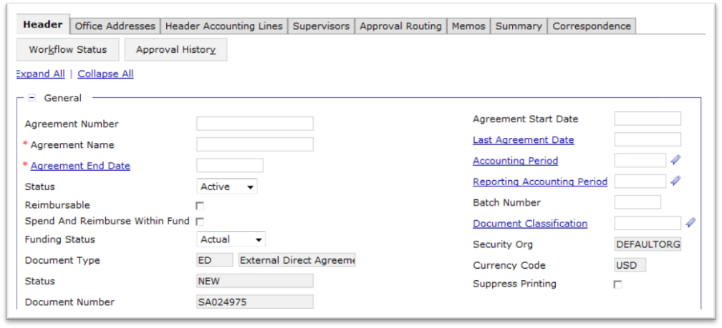
Rename Original Document Date
7.1.2 Enhancement
Original Document Date field on the Agreement Header is renamed to Agreement Start Date to easily determine when the agreement was first created.

Slide 98
Segment 9:
Accounts Payables Enhancements

Slide 99
Accounts Payable Functionality Overview
The Momentum Accounts Payable module allows the user to authorize payments to vendors, employees, or other agencies for goods or services provided. The user can:
Authorize payments manually or generate them automatically based on an agency’s operating procedures.
Issue prepayment and apply prepaid amounts to subsequent invoices, manage contract withholdings, and apply credits to existing or future payments.
Apply manual interest & penalty charges or manual discounts to payments and issue refunds of over-collections or advances.
Payments are automatically scheduled for disbursement according to prompt payment regulations, vendor payment terms, and available discounts.

Slide 100
Accounts Payable Functionality Overview
The Accounts Payable subsystem allows users to record the different steps needed in the authorization and scheduling of payments for disbursement via:
Recording expenditures for payments to vendors, employees, and other government agencies.
Establishing and releasing holdbacks and suspensions.
Issuing and applying prepayments.
Replenishing and recording monies disbursed from the user’s impress fund.
Specifying the disbursing method associated with authorized payments, including no check inter-agency, and check/EFT disbursements.
Automatically scheduling payments for disbursement according to prompt payment regulations, vendor payment terms, and available discounts.
Tracking the status of payments throughout the disbursements process.
Performing extensive queries on entered transactions.
Generating standard and user defined reports.

Slide 101
Accounts Payable Enhancement Overview
Support Do Not Pay
Accounts Payable Transaction New Fields
Log Date

Slide 102
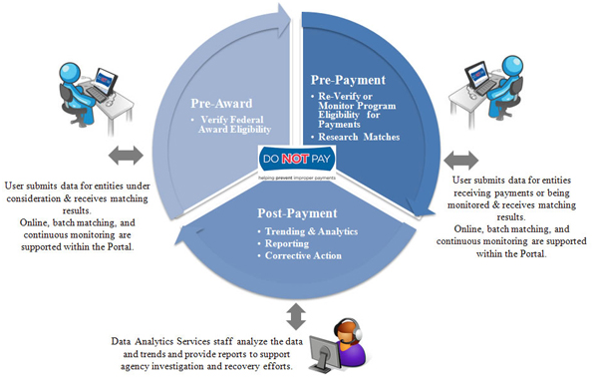

Support Do Not Pay – Business Reason
The Treasury Do Not Pay application was created to assist federal agencies with a two part mission:
Preventing, reducing and stopping the disbursement of improper payments.
Identifying and mitigating fraud, waste, and abuse.
Do Not Pay includes a web portal that allows agencies to check various government databases before making payments or awards in order to identify ineligible recipients and prevent fraud or errors from being made.

Slide 103
Support Do Not Pay – Enhancement Business Process
7.1.2 Enhancement- Business Process
Two Way Validation
Information extracted from Pegasys for submission to Do Not Pay can be validated against the Do Not Pay system.
Do Not Pay will provide a downloadable file of matching data that can automatically update vendor records in Momentum as ‘Do Not Pay’.
Vendors marked as ‘Do Not Pay’ will result in various notifications to users regarding the vendor's Do Not Pay status when creating any new obligations, payments, or agreements containing that vendor.
7.1.2 Enhancement Features (see subsequent slides)
New Batch Job
Vendor Code Maintenance table and Vendor Form field additions
Support Do Not Pay flag additions
Overrideable Warnings
Notes:
Takes file from treasury and marks file as do not pay. Will support generating a do not pay from pegasys to tell treasury which vendors not to use. GSA has chosen to used only the outbound batch job.
New outbound batch job

Slide 104
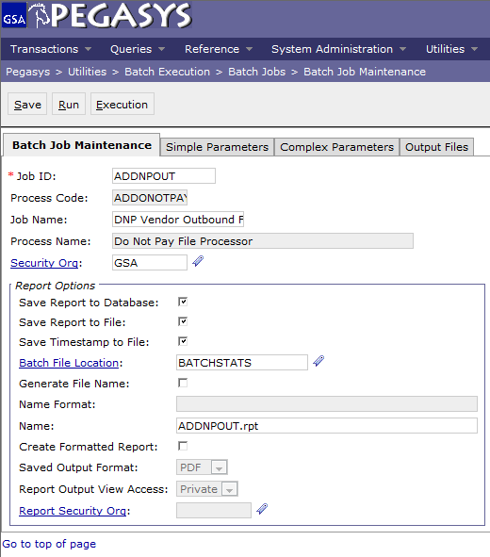
Support Do Not Pay - Pegasys
New Support Do Not Pay Batch Job
ADDNPOUT - Do Not Pay Output Files batch process
Allows GSA to pull vendor and/or payment data out of Pegasys using a variety of simple and complex parameters to create a vendor and/or payment file that can be uploaded to and processed by Do Not Pay.
Notes:
Identify vendors they don’t want, put on batch job, send to treasury. Batch job. Flag has to be checked on vendor table, gsa determines in advance and puts it in the batch job parameters.

Slide 105
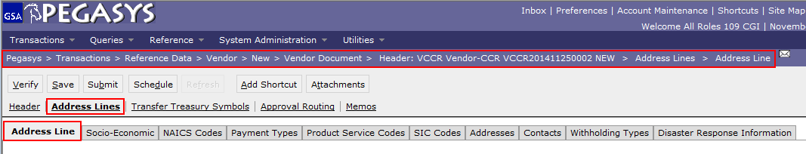
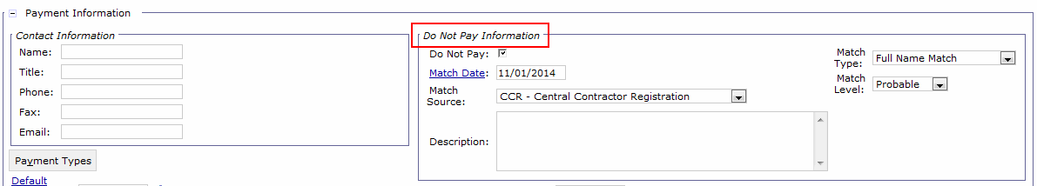
Support Do Not Pay – Pegasys
Vendor Code Maintenance table and Vendor Form field additions:
Via the Vendor Forms and the Vendor Code Maintenance table, users can record information in Pegasys regarding a vendor’s Do Not Pay status:
Notes:
C-957444
Match date, match source are all values that are populated on inbound file. Gsa is not using inbound process so the match will not be populated.

Slide 106
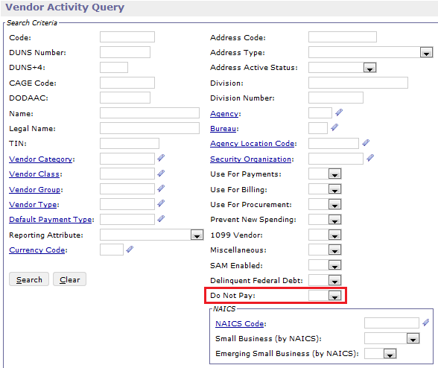
Support Do Not Pay - Pegasys
Do Not Pay flag additions to the:
Vendor Activity Query
Vendor Review Query
Invoice Query

Slide 107
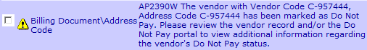
Support Do Not Pay - Pegasys
An overrideable warning will be added to the following areas of Pegasys to notify a user if a vendor that is configured as “Do Not Pay” is used:
Verifies that vendors are eligible for payment prior to disbursing funds.
Obligations:
Order (IO)
Training Order (IT)
Award (QA)
Acquisition Order (QO)
Travel Authorization (TA)
Payments:
Payment Authorization (IP)
Imprest Fund (IF)
Travel Advance (TN)
Third Party Payment (TP)
Travel Voucher (TV)
Bank Withdrawal (BW)
Bills and Cash Receipts (Advance line type only)
External Agreements
Contract maintenance table
Blanket Purchase Agreement maintenance table
Notes:
Billing Doc with Do Not Pay, Save Form, show error – GDN-0022

Slide 108
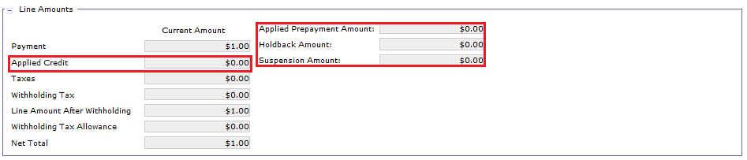
Accounts Payable Transaction New Fields
7.1.2. Enhancements
Accounts Payable Transaction New fields:
On Summary, Header Accounting Line and Itemized Accounting Lines tabs:
Applied Credit
Applied Prepayment Amount
Holdback Amount
Suspension Amount
Notes:
Grab P8 Document and show fields Applied Credit, Applied Prepayment Amt, Holdback Amount, Suspension Amount.
P820140304000000

Slide 109
Log Date
Log Date Business reason
Log dates document the date of receipt for the invoice and are captured on the Invoice form when GSA is invoiced by a vendor for goods or services.
7.1.2. Enhancements
Log Date new edit
The Log Date for transactions with an invoice number must match on all transaction lines which reference that invoice.
Lessens manual errors when users are referencing invoices.
Log dates trigger prompt pay. Consistent Log dates ensure interest and penalties are calculated properly.
Notes:
The Log Date from the Invoice and the Payment match as a trigger for Prompt Pay Codes in certain scenarios.
Order receipt invoice payment

Slide 110
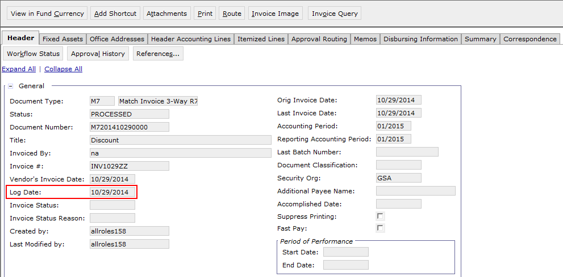
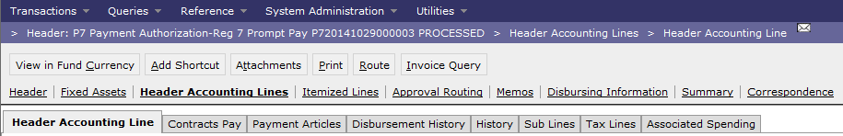
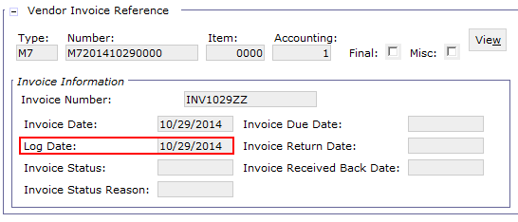
Log Date
Invoice & Payment Log Date fields
Notes:
Slide 36- Show M7 Invoice and P7 Payment. M7201410290000, P720141029000003

Slide 111
Segment 10:
Automated Disbursements Enhancements

Slide 112
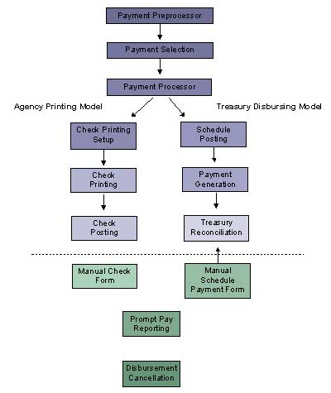
Automated Disbursements Functionality Overview
As payment transactions are processed, they are scheduled for disbursement based on prompt payment regulations, vendor payment terms, and offered discounts.
Processed payment transactions remain warehoused in the Undisbursed Payments Query until their assigned schedule date, at which point they are selected by the automated disbursements process.
Notes:
Payment transactions (itemized payments, imprest fund replenishments, and travel payments). GSA uses Treasury Disbursing Model.
Uses automated match. Scheduled based on prompt pay. It goes on the undisbursed payment query. Series of batch jobs that are run each day to generate payment file. Payment processor- not used. Payment select- schedule date, interest penalty, payment processor- orders payments per treasury’s requirements, scheduled posting, makes system end users see- schedule #, query. Payment generate creates file for check/eft. Reconciliation- user enters check records and information. records and creates check and eft.
Manual scheduled document- used for foreign disbursements.

Slide 113
Automated Disbursements Functionality Overview
The Automated Disbursements Module:
Sends Payments to Treasury
Determines whether a payment is subject to Prompt Payment based on options the user specifies for each document type, vendor type, and transaction definition.
Groups eligible check and Electronic Funds Transfer (EFT) payments using invoice and payment information.
Calculates applicable interest or discounts applied to the payment, including the interest amount, number of interest days.
Records Treasury Schedule Confirmation
Enables users to record Treasury schedule confirmation details.
Records Treasury Check and EFT Numbers and payment details on the Check and EFT Queries.
Manages any Cancellations
Allows users to record check and EFT payment cancellations.
Notes:
Users grabs confirmation information, records on schedule query, runs treasury reconciliation to update check trace numbers.

Slide 114
Automated Disbursements Enhancements Overview
Improved Querying of Disbursement Cancellation
Support PAM 5.0.0 Format
Additional PAM Enhancements
Schedule Query updates
Miscellaneous AP and Disbursement Enhancements
Accounts Payable Transaction new fields
Log Date edits

Slide 115
Automated Disbursements – Improved Querying of Disbursement Cancellations
Automated Disbursements Cancellation Business Process:
Payment cancellations should be entered immediately into Pegasys by creating a Disbursement Cancellation (CX) document.
A Disbursement Cancellation document enables cancellation of a payment for a number of scenarios:
Replace a check if a payment was lost.
Reissues a payment and re-opens the invoice so that it can be corrected.
Deletes a payment and closes the chain if the invoice will never be paid.
Notes:
The Improved Querying of Disbursement Cancellations allows GSA to view the Disbursement Cancellation (CX) document in the Reference query with greater visibility and auditability for cancelled checks and EFT payments. The CX has been a special case, compared to other transactions in the Reference query, because its references are indirect. That is, the CX directly references a disbursement schedule detail, which itself may consist of multiple payment transactions. By showing a CX (and cancellation type) in a payable document’s Reference query, it is easier for agencies to quickly identify whether and how (e.g., for Deletion, Reissue, or Replacement) a payable’s disbursement has been cancelled.
Reissue- goes through process again, puts on query again. Replace a check- goes out the same without changes to amount or prompt pay. Cancel for deletion- payment should not have been entered. The initiating payment doc is out as well

Slide 116
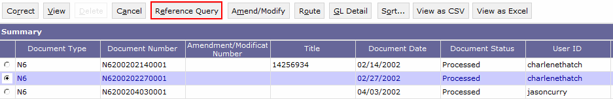
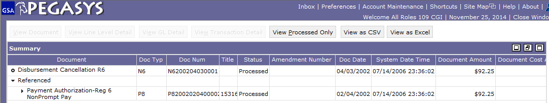
Automated Disbursements – Improved Querying of Disbursement Cancellations
7.1.2 Enhancement Features:
Allows GSA to view the Disbursement Cancellation (CX) document in the Reference Query.
Provides greater visibility and auditability for cancelled checks and EFT payments.
The CX directly references a check or EFT payment, which itself may consist of multiple payment transactions.
Displays a CX in a payable document’s Reference Tree.
Easier to quickly identify whether a payable’s disbursement has been cancelled.
Notes:
N6/N7 document type – N6200202270001
Payments awaiting replacement query- automated disbursements (PARQ)
Disbursement Cancellations Awaiting Reconciliation Query – cancelled something you didn’t officially put into books. You will go in and make final posting activity once you run batch job. Any cancellation on the query is waiting to be picked up by batch job.

Slide 117

Automated Disbursements: Support PAM File Format Version 5.0.0
Business Reason:
Effective October 1, 2014, all Federal Program Agencies using Treasury disbursing services are required to submit payment data using the Payment Automation Manager (PAM) Standard Payment Request (SPR) format.
GSA submitted disbursement files to Treasury using the Treasury Bulk File format. PAM consolidates more than 30 legacy applications into a single application that will process agency payment requests in a more efficient and cost effective manner.
The PAM file format will also enable agencies to provide the Treasury Account Symbol (TSYM) and Business Event Type Code (BETC) that is required for agencies to become Central Accounting and Reporting System (CARS) reporters.
Notes:
Treasury Bulk File Format will be obsolete. Provide vehicle for business to provide betc. As of 10/1 all agencies shave to be on new pam format. When you become reporter, you have to provide both the tas and BETC.

Slide 118
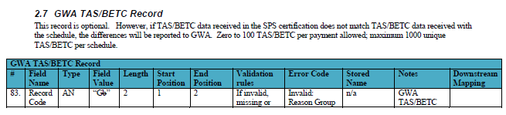
Automated Disbursements: Support PAM File Format Version 5.0.0
7.1.2 Enhancement Features
Updates the disbursement output file into PAM format.
Contains most of the same fields that have already been stored on payment transactions output file record.
Intended for GSA to submit one file with one or more schedules.
Includes new record positioning capturing TSYM-BETC information for ALCs as they become GWA reporters.
Notes:
Live in pegasys today, to support by 10/1.

Slide 119
Automated Disbursements: Additional PAM Enhancements
Schedule Query:
Queries > Automated Disbursements > Schedule Query
The schedule number generated from the NADSCHPOST batch process is placed on the Payment document.
Users can then use the Schedule Number to identify payments associated to the schedule on the Schedule Query.
Displays summary schedule information for each generated schedule, such as date submitted, number of payments, and total voucher amount.
Reflects the most recent activity recorded for the schedule.
For example, when the user enters Treasury's confirmation or rejection of the schedule, the resulting schedule status, confirmed/rejected date, and confirmed/rejected amount are displayed on the query.
Notes:
Shows schedules disbursed to treasury

Slide 120
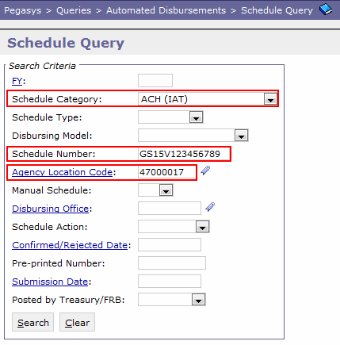
Automated Disbursements: Additional PAM Enhancements
7.1.2 Enhancement
Schedule Query Updates:
Schedule Category of International ACH Transaction (IAT) Added.
Distinguishes EFT payments made to domestic banks where the recipient has a foreign address.
Schedule Number length is increased from 9 characters to 14 characters.
Agency Location Code added.
Notes:
US businesses with a foreign address. Japanese business with foreign address. GSA not using IAT, but its in drop down. The schedule number length has increased to 14 characters but gsa sticking to 9. ALC now also appears on schedule query.

Slide 121
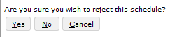
Automated Disbursements: Additional PAM Enhancements
7.1.2 Enhancements
Schedule Query Updates cont.:
NADSCHPOST defaults schedules to No Action. Users must either
Manually Confirm schedule to update GL and make schedule eligible to be sent to Treasury. OR
Manually Reject schedule to reset and restart Disbursement Process.
Schedule Query Schedule Rejection Confirmation message
Adds a confirmation message which will be displayed to the user prior to completing a schedule rejection.
Lessens the chance that a schedule is inadvertently rejected.
Notes:
After Running Schedule number, you have to go to the Schedule query to do one of three things. NADSCHPOST batch process sets it as No Action. No action schedules, reject it, or confirm it. If you confirm it, it will update GL and sent to Treasury. If you reject the schedule, it will be reset and you have to go through the disbursement process again.
Presents schedule that Contains a number. You can approve or Reject entire schedule or take no action.
Rejections can’t be undone. Before you can save rejected schedule you have to click yes.

Slide 122
Segment 11:
Vendor Customer Self Service (VCSS)
Enhancements

Slide 123
VCSS Enhancement Overview
Allow for Input Files in VCSS
Transmit Itemized Order Corrections to VCSS

Slide 124
VCSS Functionality Overview
Provides a single location for vendors and financial analysts to access invoice and payment information
Submit invoices and view payments
Download hard copy documents
Vendor
VCSS
Review account status and balances
Send/review electronic communication
Launch websites to external systems and pay statements online
Export information to Excel
Financial Analyst
Confidential

Slide 125

Transmit Itemized Order Corrections to VCSS – Business Process
Orders:
Placed when an agency is ready to purchase a specific item from a vendor for an agreed-upon price.
Can also be associated with previously entered reservations and requests and can later be referenced by invoices, receipts, and payments.
Purchasing chain:
Orders in Pegasys & VCSS
Itemized Order (IO) document category.
Can be created Manually or using Copy Forward Functionality.
Lines can be copied forward on the Header Accounting lines, the Itemized lines, or both.
In Pegasys 6.5 new and amended orders are posted to VCSS, but order corrections are not posted.
Notes:
when gsa creates the order (and the vendor exists in vcss) the order syncs with vcss so the vendor can view it. then they create a referenced invoice from that order
there is a button: Create Referenced Invoice
Vendor has VRN# so its been sent to vcss.

Slide 126
Transmit Itemized Order Corrections to VCSS
7.1.2 Enhancement
Order corrections will also be posted to VCSS upon Processing.
Ensures customers are presented with the most current order information, which will facilitate the submission of more accurate invoices.
Configured customers will receive emails from VCSS when the order correction is posted to for fields that are displayed in the VCSS user interface.
Attachments associated with order corrections will also be available for viewing.

Slide 127
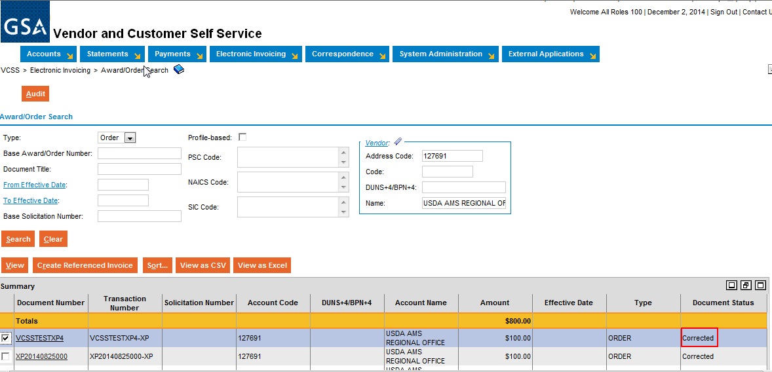
Transmit Itemized Order Corrections to VCSS

Slide 128
Allow for Input Files in VCSS – Functionality Overview
VCSS Input file Functionality Overview
Allows for Input files in VCSS enhancement provides a mechanism to allow vendors to upload invoices into VCSS in an attempt to reduce the data entry required with entering multiple invoices into VCSS.
7.1.2 Enhancement
Will not replace the existing process for creating invoices in VCSS, but will complement the existing functionality by providing an alternative method to vendors for entering multiple invoices in VCSS through a file upload process using comma-separated value (CSV) formatted spreadsheets.
User receives email upon successful and unsuccessful input.
Notes:
Reservation/Request/Order/Receipt/Invoice
Invoices can be manually created by gsa in pegasys, they can be entered in vcss by the vendor and sync to pegasys, or they can come in through form import.
In vcss there is a screen for them to manually enter the invoice in vcss. when it comes in through form import the file is sent over by another application (ex. VITAP) and we run the form import job to create the documents in Pegasys
Allroles100- make sure on file there is a vendor registration number#. If you open in excel it changes to scientific number. Make sure that # is an actual #.
Vrn- when its created in momentum it has a vendor number. Not all vendors in pegasys are in vcss. When the transfer occurs, when you want it to also go into vcss, you click a button to send it to vcss and it gets a vrn#. gets synced into vcss.

Slide 129
Allow for Input Files in VCSS
7.1.2 Enhancement Overview
Menu Structure Updates:
Electronic Invoicing menu structure to provide a new option for uploading invoices into VCSS.
System Administration menu structure to provide a new option for reviewing the status of the invoice upload batch process executions.
Invoice Search Page new search criteria & item collection:
Invoice Upload Confirmation Number
Invoice Upload File Name
Invoice Upload Date/Time
New Invoice View fields: – read only and populated by system by invoice upload batch process:
Batch Number
Invoice File
New Optional fields: – fields no longer required:
Invoice Office Code
Invoice Office Address Code
Invoice Upload Execution Query Security Updates:
Addition of Default Invoice Upload Security Organization field to the VCSS System Settings.
Applies only to Query
Security Organization will not be used for securing attachments associated with a created invoice in VCSS.

Slide 130
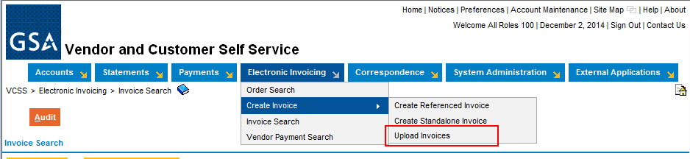

Allow for Input Files in VCSS
Creating Invoice with Input File:
Electronic Invoicing > Create Invoice > Upload Invoices
Select Browse.

Slide 131

Allow for Input Files in VCSS
Select file and select Open.
Select Upload.

Slide 132



Allow for Input Files in VCSS
Optional: Select Upload Invoice Attachments?
Select Next.
Select Submit.

Slide 133
Segment 13:
Additional Items

Slide 134
Additional Items
Login Confirmation Messages
Blank Rows
Secured Field Searching
Identity Provider (IdP) tabs
Setting Up Security Questions

Slide 135

Login Confirmation Message
Upon Logging into Pegasys, users will receive a Confirmation Message through the Identity Provider (IdP) authenticating the user.
Warning Message if Security Questions are not set up.
Warning Message for unsuccessful login attempts.
Time and Date of last successful login.
Users must click OK to get to Pegasys Inbox.

Slide 136


Blank Rows
For rows that are blank, the user needs to select the row and then click in the cell to add information or for a drop down menu to appear.
Blank rows may be automatically defaulted.
On some screens, blank rows appear upon hitting the “Add” button.

Slide 137

Secured Field Searching
Users searching a secured field (Vendor Code, DUNs, TIN, etc.) no longer need to input a Security Organization.
Secured field permissions are still checked when a user is performing a search on a secured field.

Slide 138

Identity Provider (IdP) tabs
The Momentum Identity Provider (IdP) provides security authentication for the Momentum Suite applications.
Authenticates users prior to logging into Pegasys rather than through the Pegasys application itself.
Selecting Account Maintenance in Pegasys will bring users to the IdP.

Slide 139

Identity Provider (IdP) Tabs
Preference tabs within IdP update IdP only and not Pegasys.

Slide 140



Setting Up Security Questions
Security Questions have been moved to the IdP:
Hit Account Maintenance in Pegasys.
Select the Security Question and Answer Page tab.
Enter your current password.
In the Summary group box, select row.
Cont. on next slide

Slide 141



Setting Up Security Questions cont.
Click within Questions row to reveal drop down.
Select security question.
Click Answers row and type answer.
Cont. on next slide

Slide 142


Setting Up Security Questions cont.
Repeat with following row.
Select Save.
“Action was Successful.” message will appear.

Slide 143

IdP Return to Pegasys
Signing out of IdP system only applies to the IdP system.
The return to application link after signing out is for IdP system.
Close the window and Pegasys system behind IdP will display.

Slide 144

Questions

